Slide 1
DISCRETE NEURAL NETWORKS FOR IMAGE CLASSIFICATION
July 12, 2017
Vikram
Summer Intern
Deepak
PhD Student

Slide 2
Why discretize?
Reduce computational/memory effort
Replace arithmetic operations with bit-wise operations
Make computation suitable for low-power hardware

Slide 3
RECENT WORKS
Binarized Neural Networks: Training Neural Networks with Weights and Activations Constrained to +1 or −1
XNOR-Net: ImageNet Classification Using Binary Convolutional Neural Networks
Matthieu Courbariaux and Yoshua Bengio in arxiv
Mohammad Rastegari and Vicente Ordonez and et.al in ECCV 2016

Slide 4
BINARIZED NEURAL NETWORK
Salient features :
Binary weights
Binary activation function
Near state of the art results.
Can reduce time complexity by about 60% ( the paper’s claim )

Slide 5
XNOR NET
Salient features:
Non Binary, standard activation functions like ReLu or sigmoid
Binary Inputs
Binary Weights
Convolution using only XNOR and bitcount operations
Scaling factor
Higher accuracy than BNN

Slide 6
COMPARISON
Using ImageNet dataset.
ACCURACY %
 | Top-1 | Top-5
BNN | 35.4 | 61.0
XNOR net | 44.2 | 69.2
Full Precison AlexNet | 56.6 | 80.2
Results : Link

Slide 7
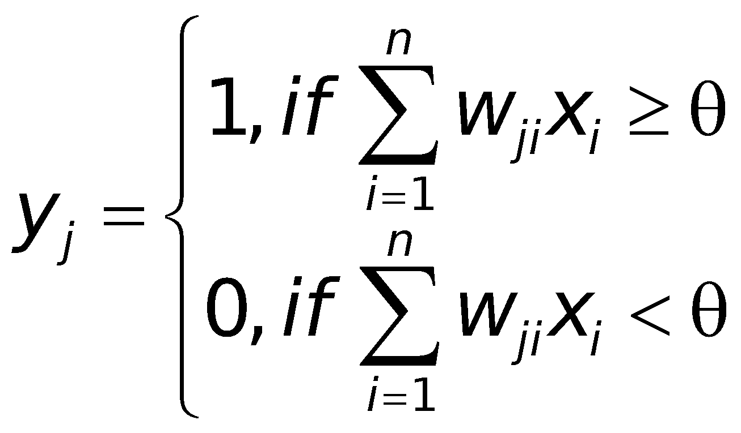
Generations of Neural Network The First Generation
The first artificial neuron was proposed by W. McCulloch & W. Pitts in 1943

Slide 8
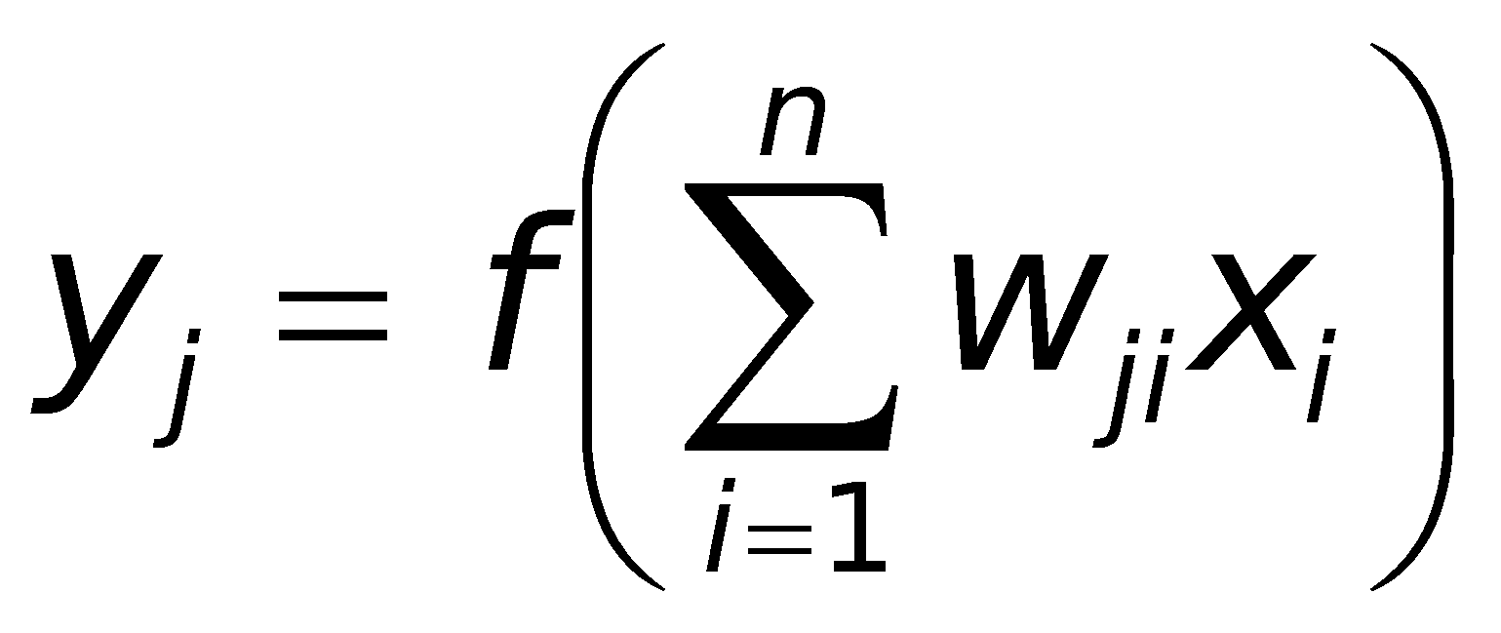
Generations of Neural Network The Second Generation
Multilayered Perception is a universal approximator

Slide 9

Generations of Neural Network The Third Generation
Spiking neuron model was introduced by J. Hopfield in 1995
Spiking neural networks are
- biologically more plausible,
- computationally more powerful,
- considerably faster
- lower energy consumption
- unsupervised by design
than networks of the second generation

Slide 10
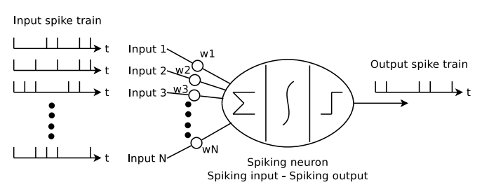
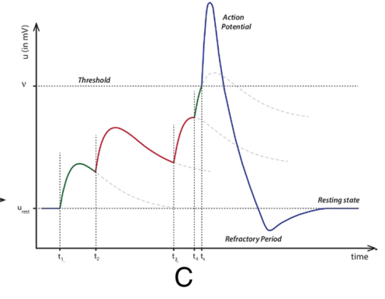
Yah, it Spikes!
Neuron integrates the current through the synapses (weights) over time and fires if the potential crosses a threshold

Slide 11
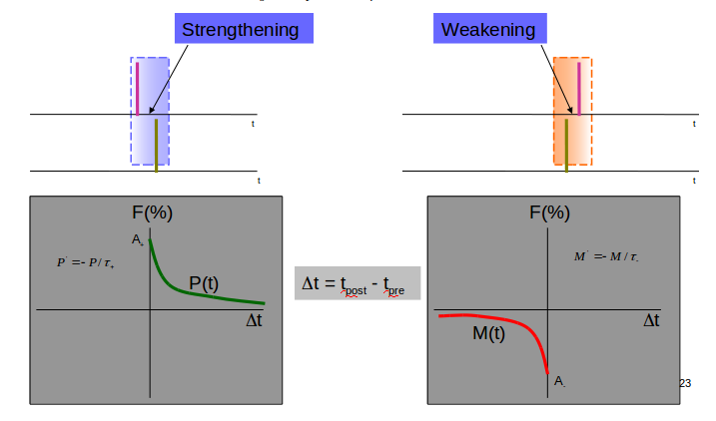
Learning using STDP

Slide 12
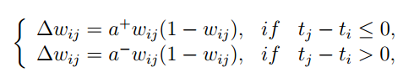
Learning using STDP
A simplified version of STDP :
STDP occurs in a winner takes all manner.

Slide 13
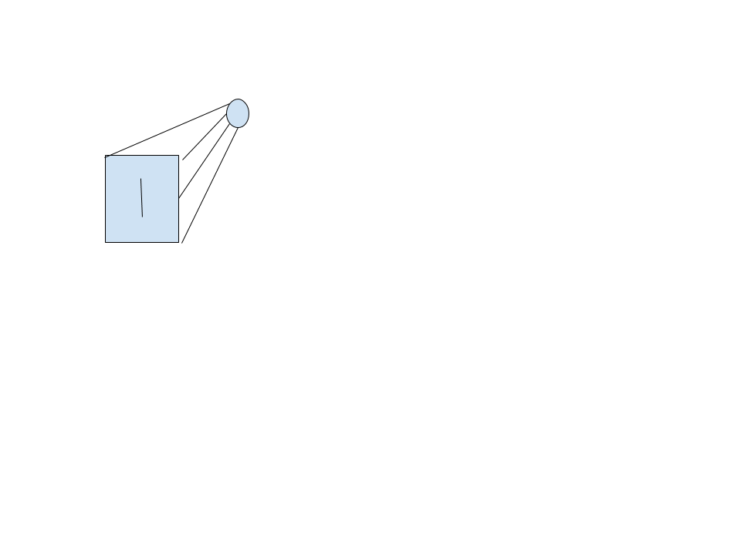

STDP
The neuron fires immediately if the pattern is close to the pattern which its weight correspond to.
Input spike train
Output spike train
Weights are reinforced more

Slide 14


STDP
The neuron fires after a long time if the pattern is not the pattern which its weight correspond to.
Input spike train
Output spike train
Weights are reinforced less
Time acts as the supervisor

Slide 15
RANK BASED TEMPORAL ENCODING
0 | 0 | 1 | 1 | 0
0 | 0 | 0 | 0 | 0
0 | 0 | 0 | 0 | 0
0 | 0 | 0 | 0 | 0
0 | 1 | 1 | 0 | 0
Time steps : 5
0 | 1 | 20 | 19 | 0
2 | 15 | 6 | 4 | 12
0 | 14 | 5 | 7 | 11
9 | 3 | 13 | 8 | 10
0 | 18 | 17 | 16 | 0
First time step
0 | 0 | 1 | 1 | 0
0 | 0 | 0 | 0 | 0
0 | 0 | 0 | 0 | 0
0 | 0 | 0 | 0 | 0
0 | 1 | 1 | 0 | 0
0 | 1 | 0 | 0 | 0
1 | 0 | 0 | 1 | 0
0 | 0 | 0 | 0 | 0
0 | 1 | 0 | 0 | 0
0 | 0 | 0 | 0 | 0
Last time step
Pixel magnitudes
Equal number of spikes each time step

Slide 16
PREVIOUS WORKS IN SNN
Less works combining deep learning and spiking neural networks
Some converting trained CNN models to SNN
Pure SNN research mostly shown on MNIST data set
Neuromorphic hardware implementation - IBM chips

Slide 17
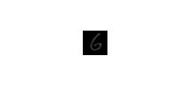
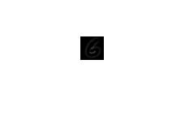

DoG
Detect positive or negative contrasts - on and off maps
Well approximates the center-surround properties of the ganglion cells of the retina
For MNIST, Caltech - Face,Bike : Sigmas - 1,2

Slide 18
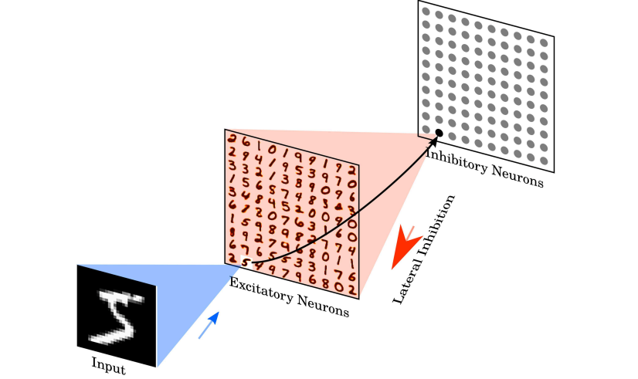
SNN - DENSE LAYER
ACCURACY : 94.91 %
Unsupervised learning of digit recognition using spike-timing-dependent plasticity
Diehl and Cook - Frontiers in Computational Neuroscience - August 2015

Slide 19
SNN - CONV LAYER
In a particular time step :
Do convolution on the output spikes of the previous layer
Add this to the voltage in the previous time step to get the current voltage
If any of the potential exceeds threshold, send an output spike and perform inhibition.
Inhibition used :
STDP is on:
Patchwise inhibition
Spatial inhibition
STDP is off:
Channel wise inhibition
STDP-based spiking deep neural networks for object recognition
Reza Kheradpisheh,, Mohammad Ganjtabesh et.al - arxiv - November 2016

Slide 20
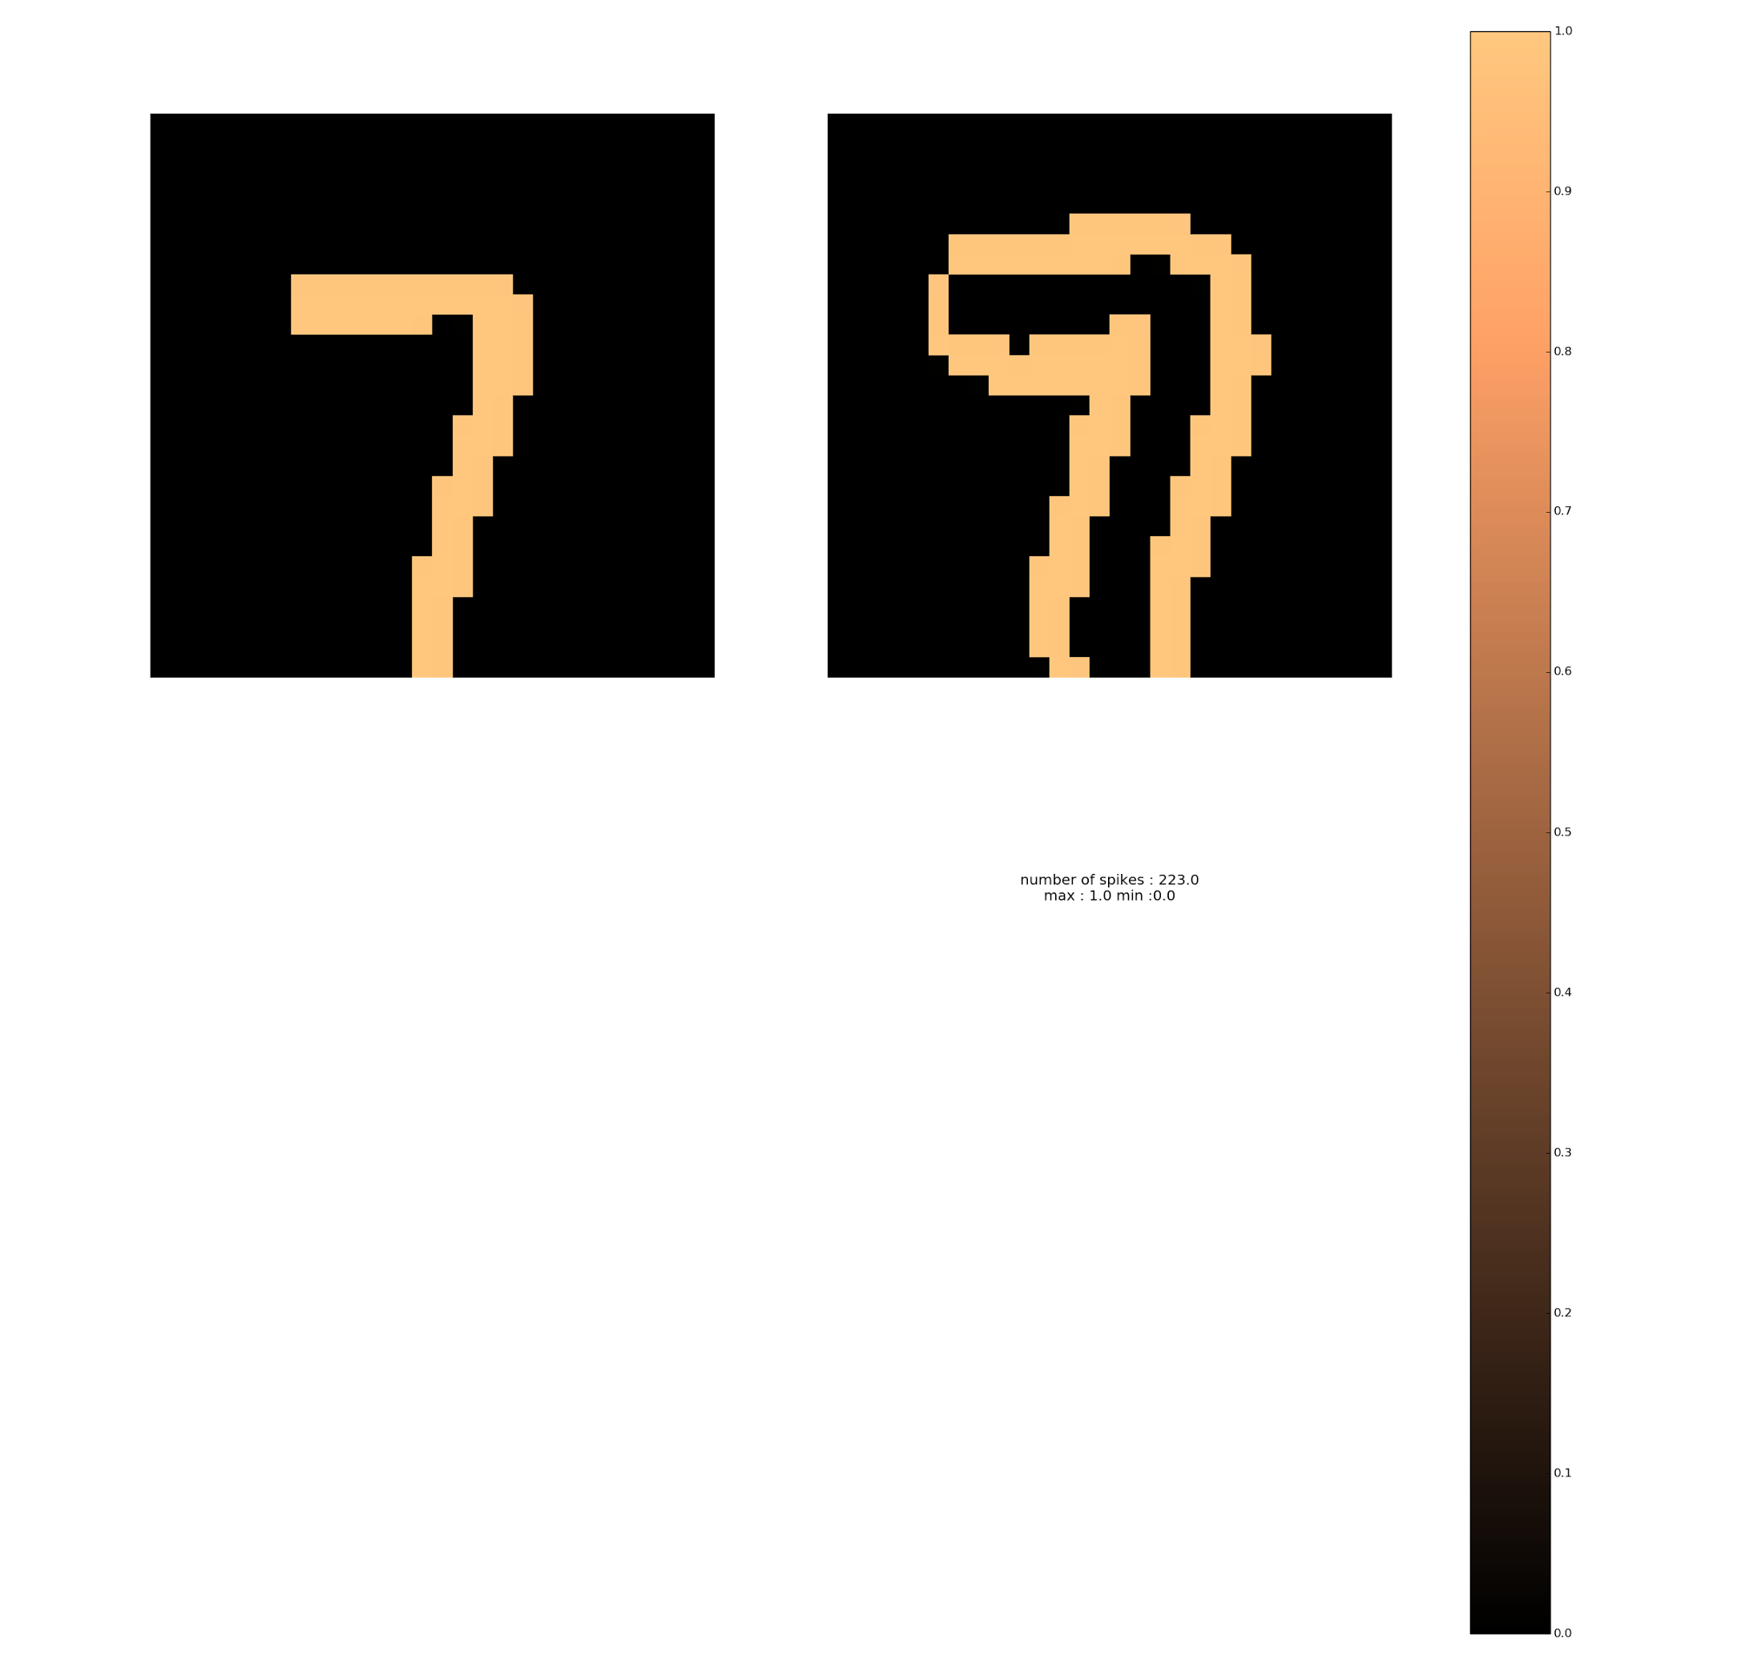
DEEP SNN - MNIST
S
O
F
T
M
A
X
CONV1
MAX POOL
Global
Max
Pooling
On
Potentials
CONV2
30 filters
100 filters
Thresh : 15
Thresh : 10

Slide 21
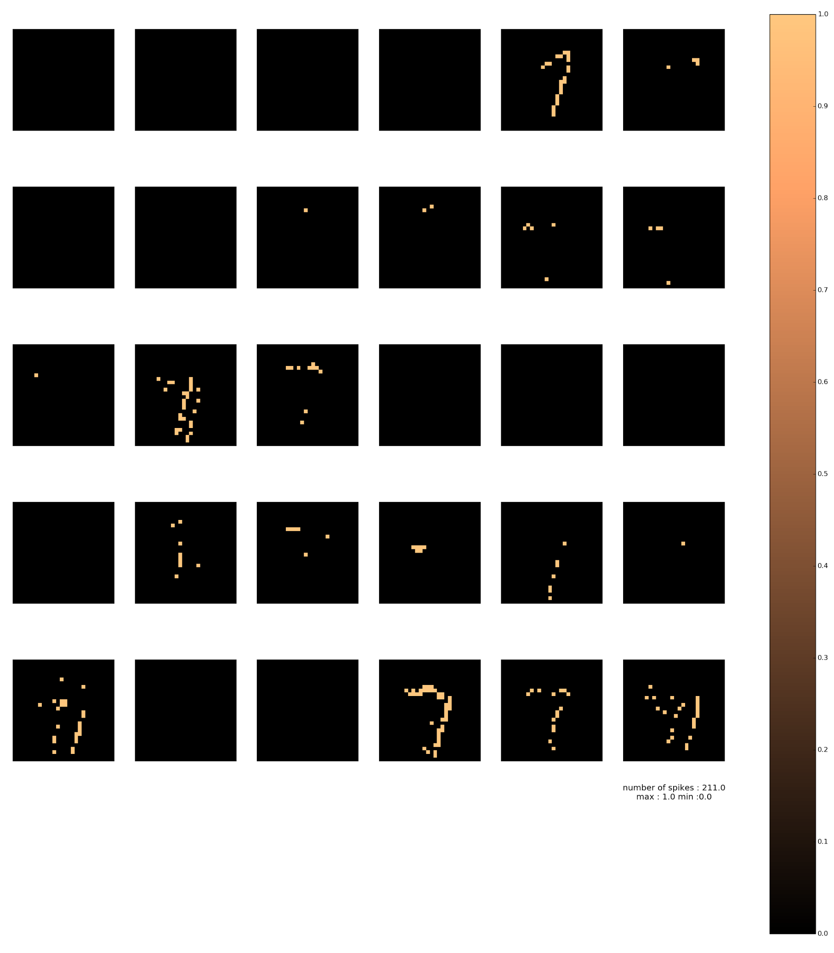
CONV1
30 filters
Thresh : 15

Slide 22
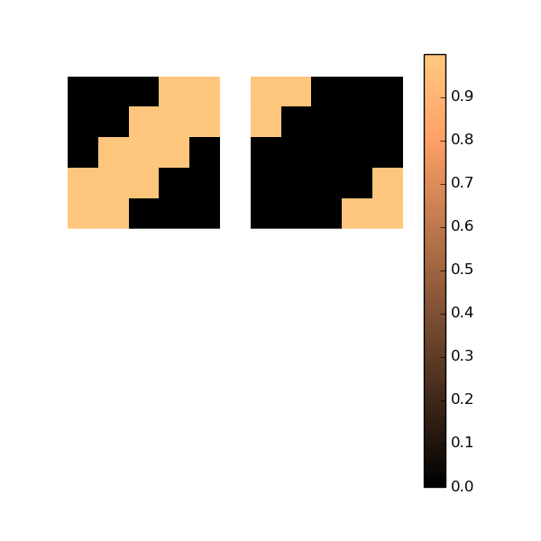
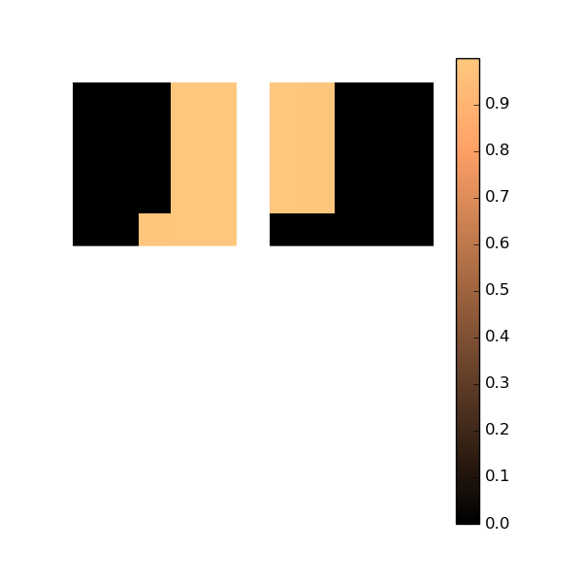
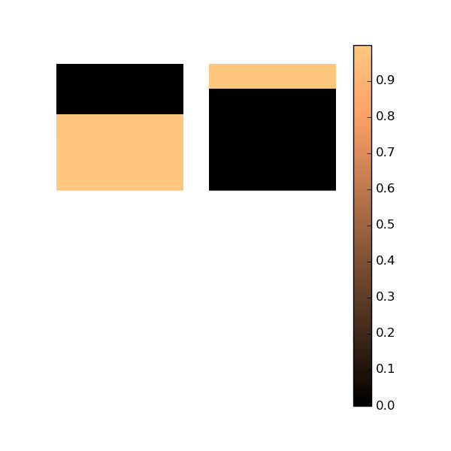
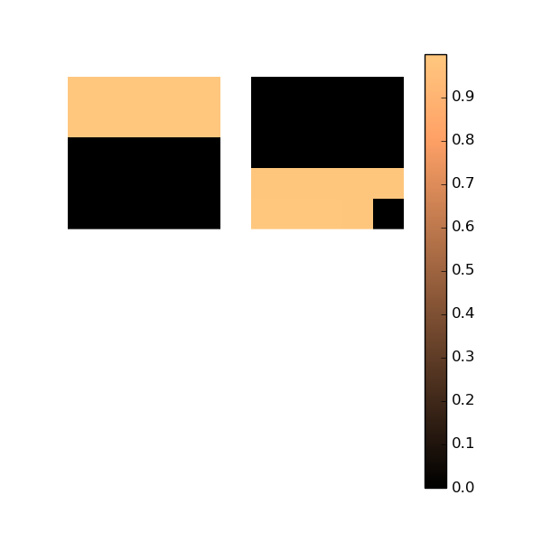
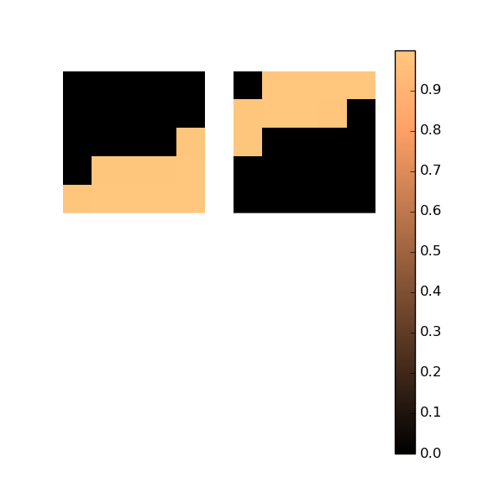
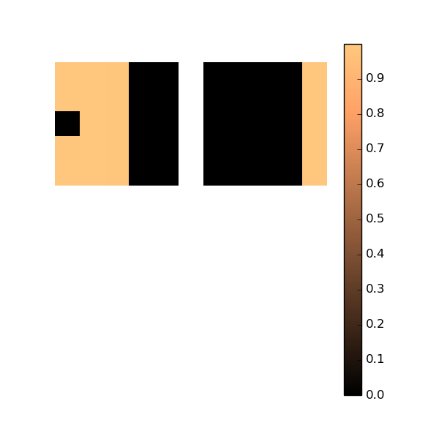
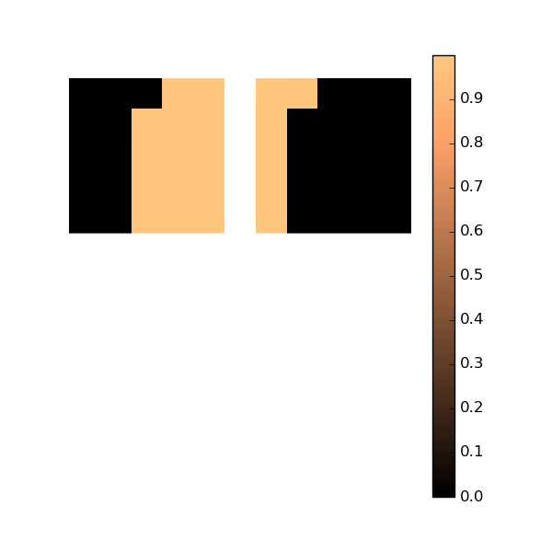
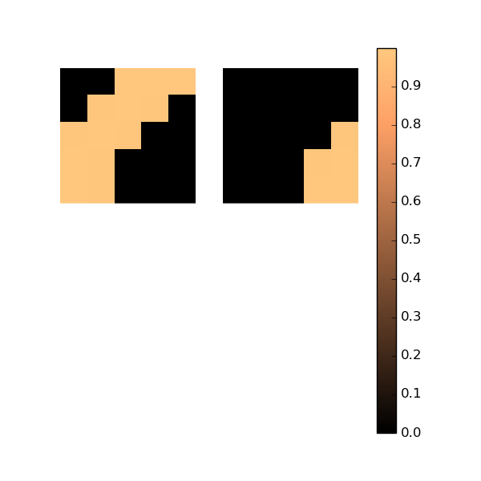
WEIGHTS - CONV1

Slide 23
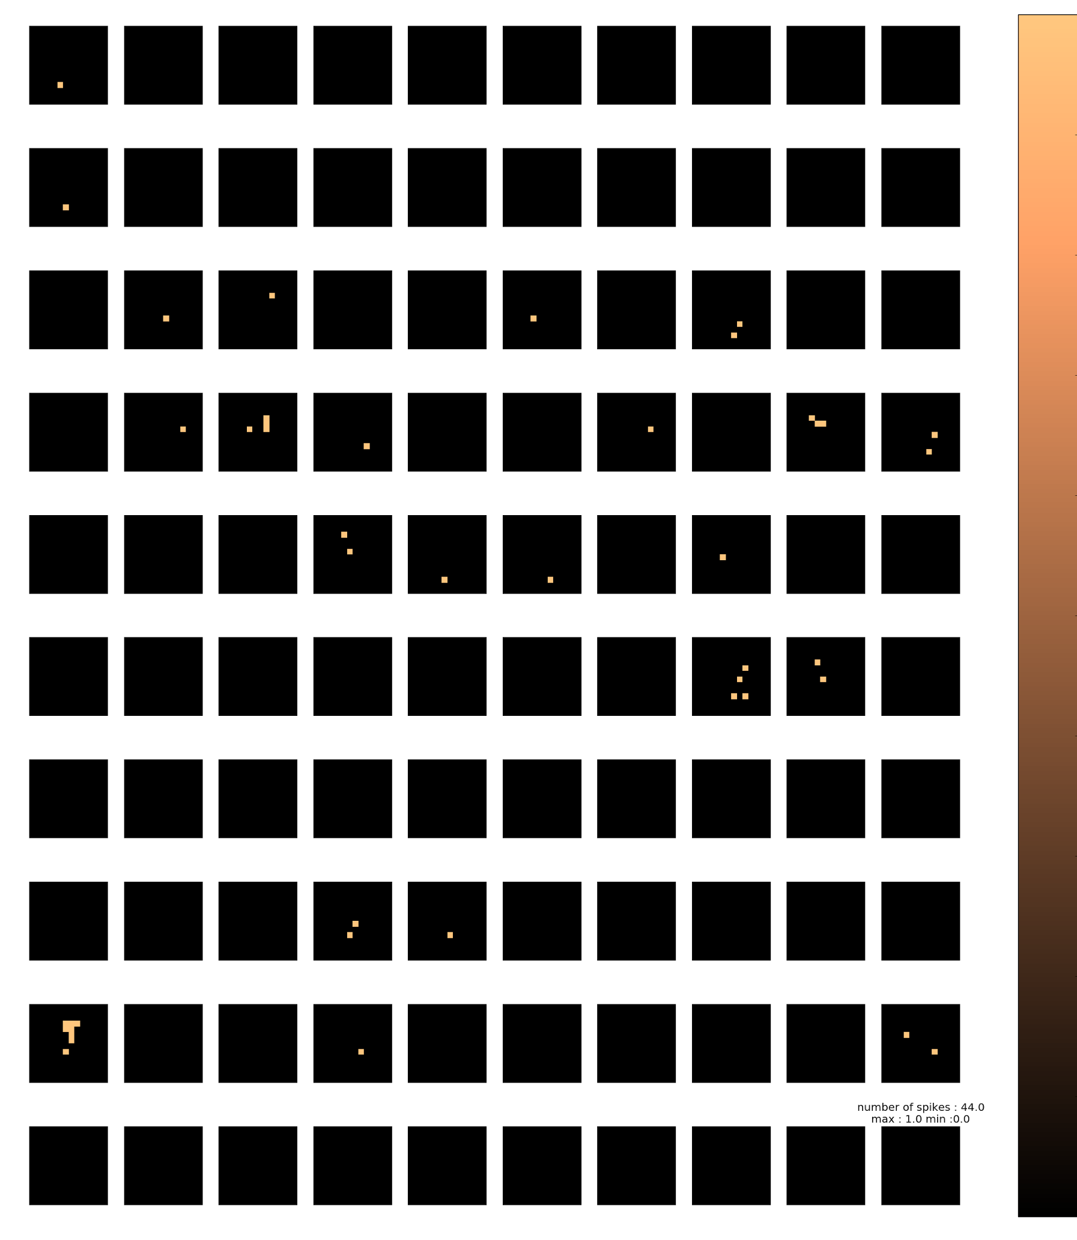
CONV1
MAX POOL
CONV2
30 filters
100 filters
Thresh : 15
Thresh : 10

Slide 24


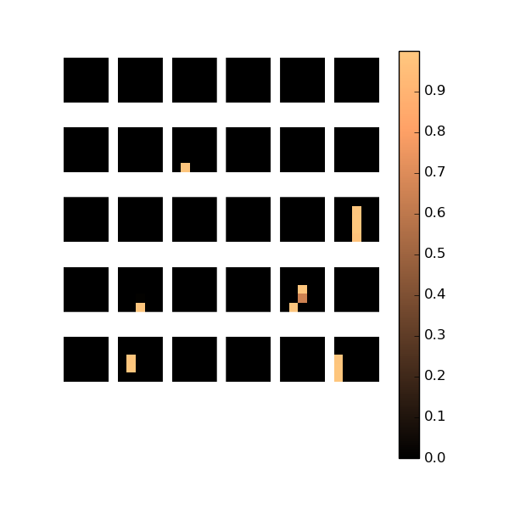
WEIGHTS - CONV2

Slide 25
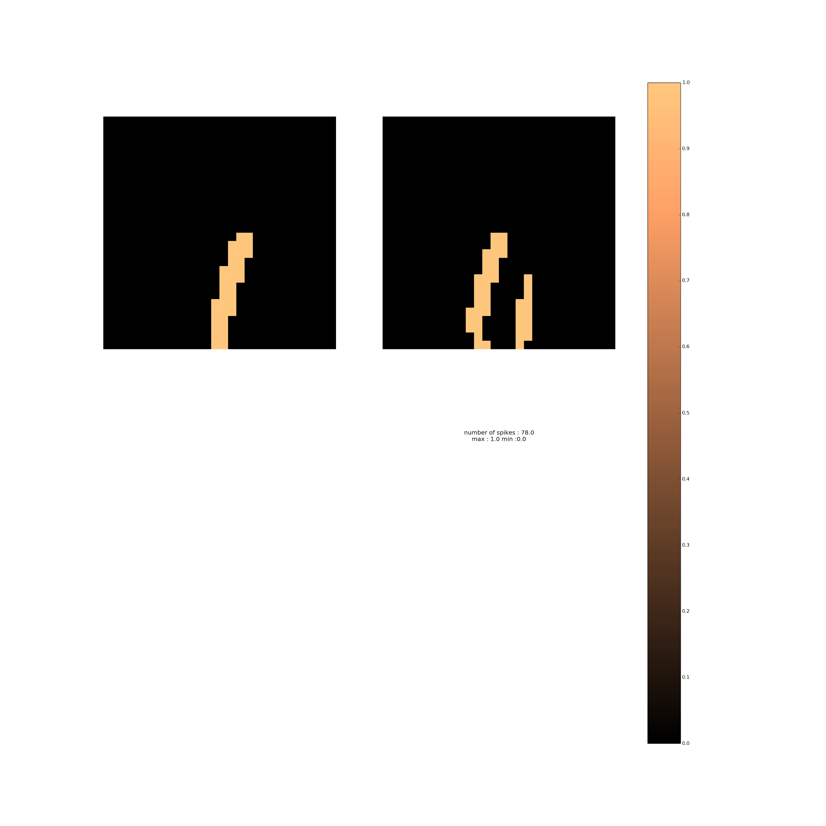
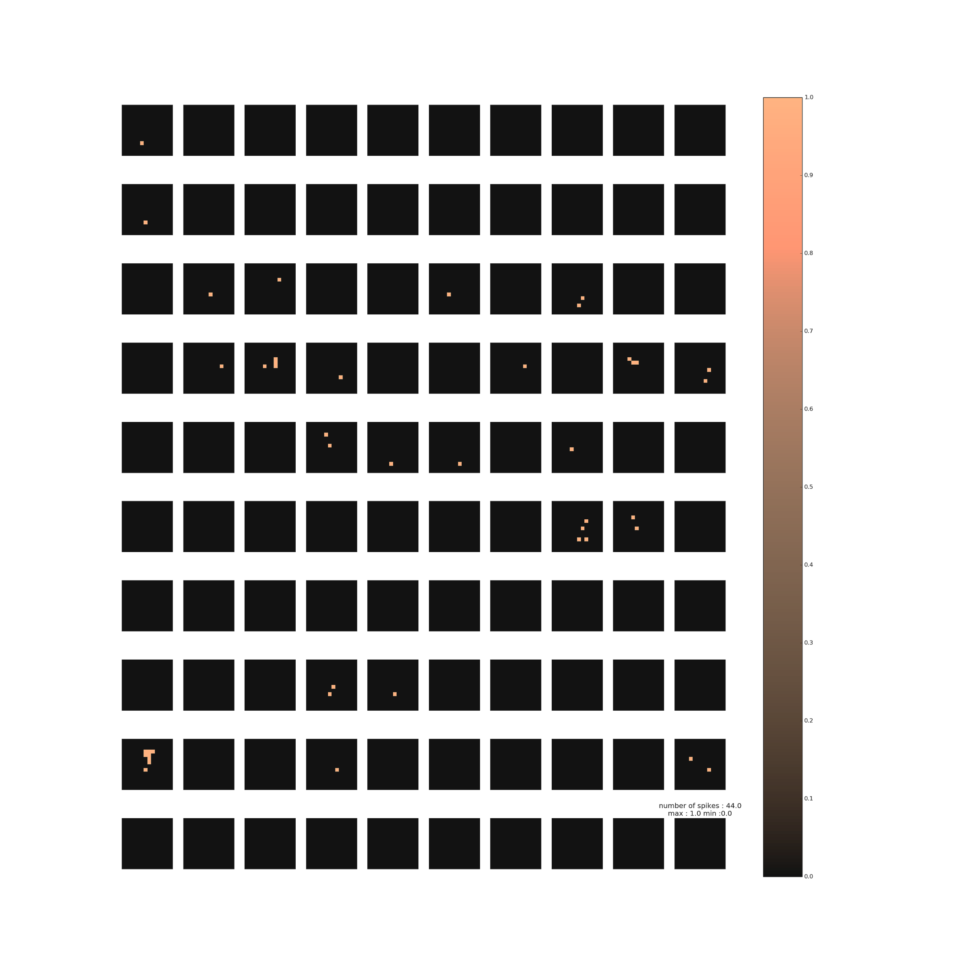
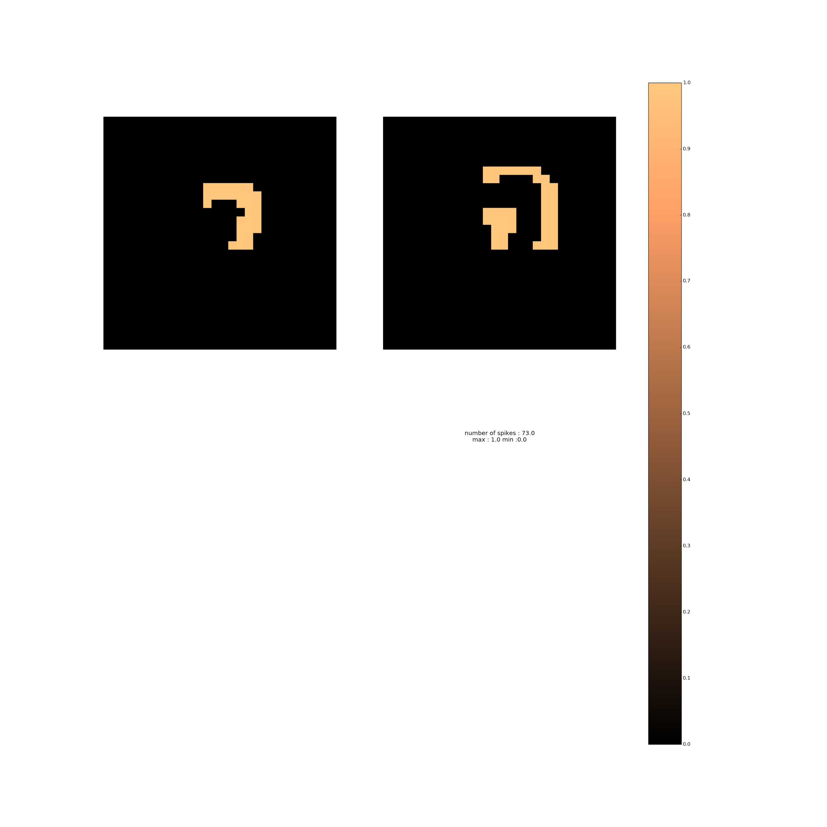
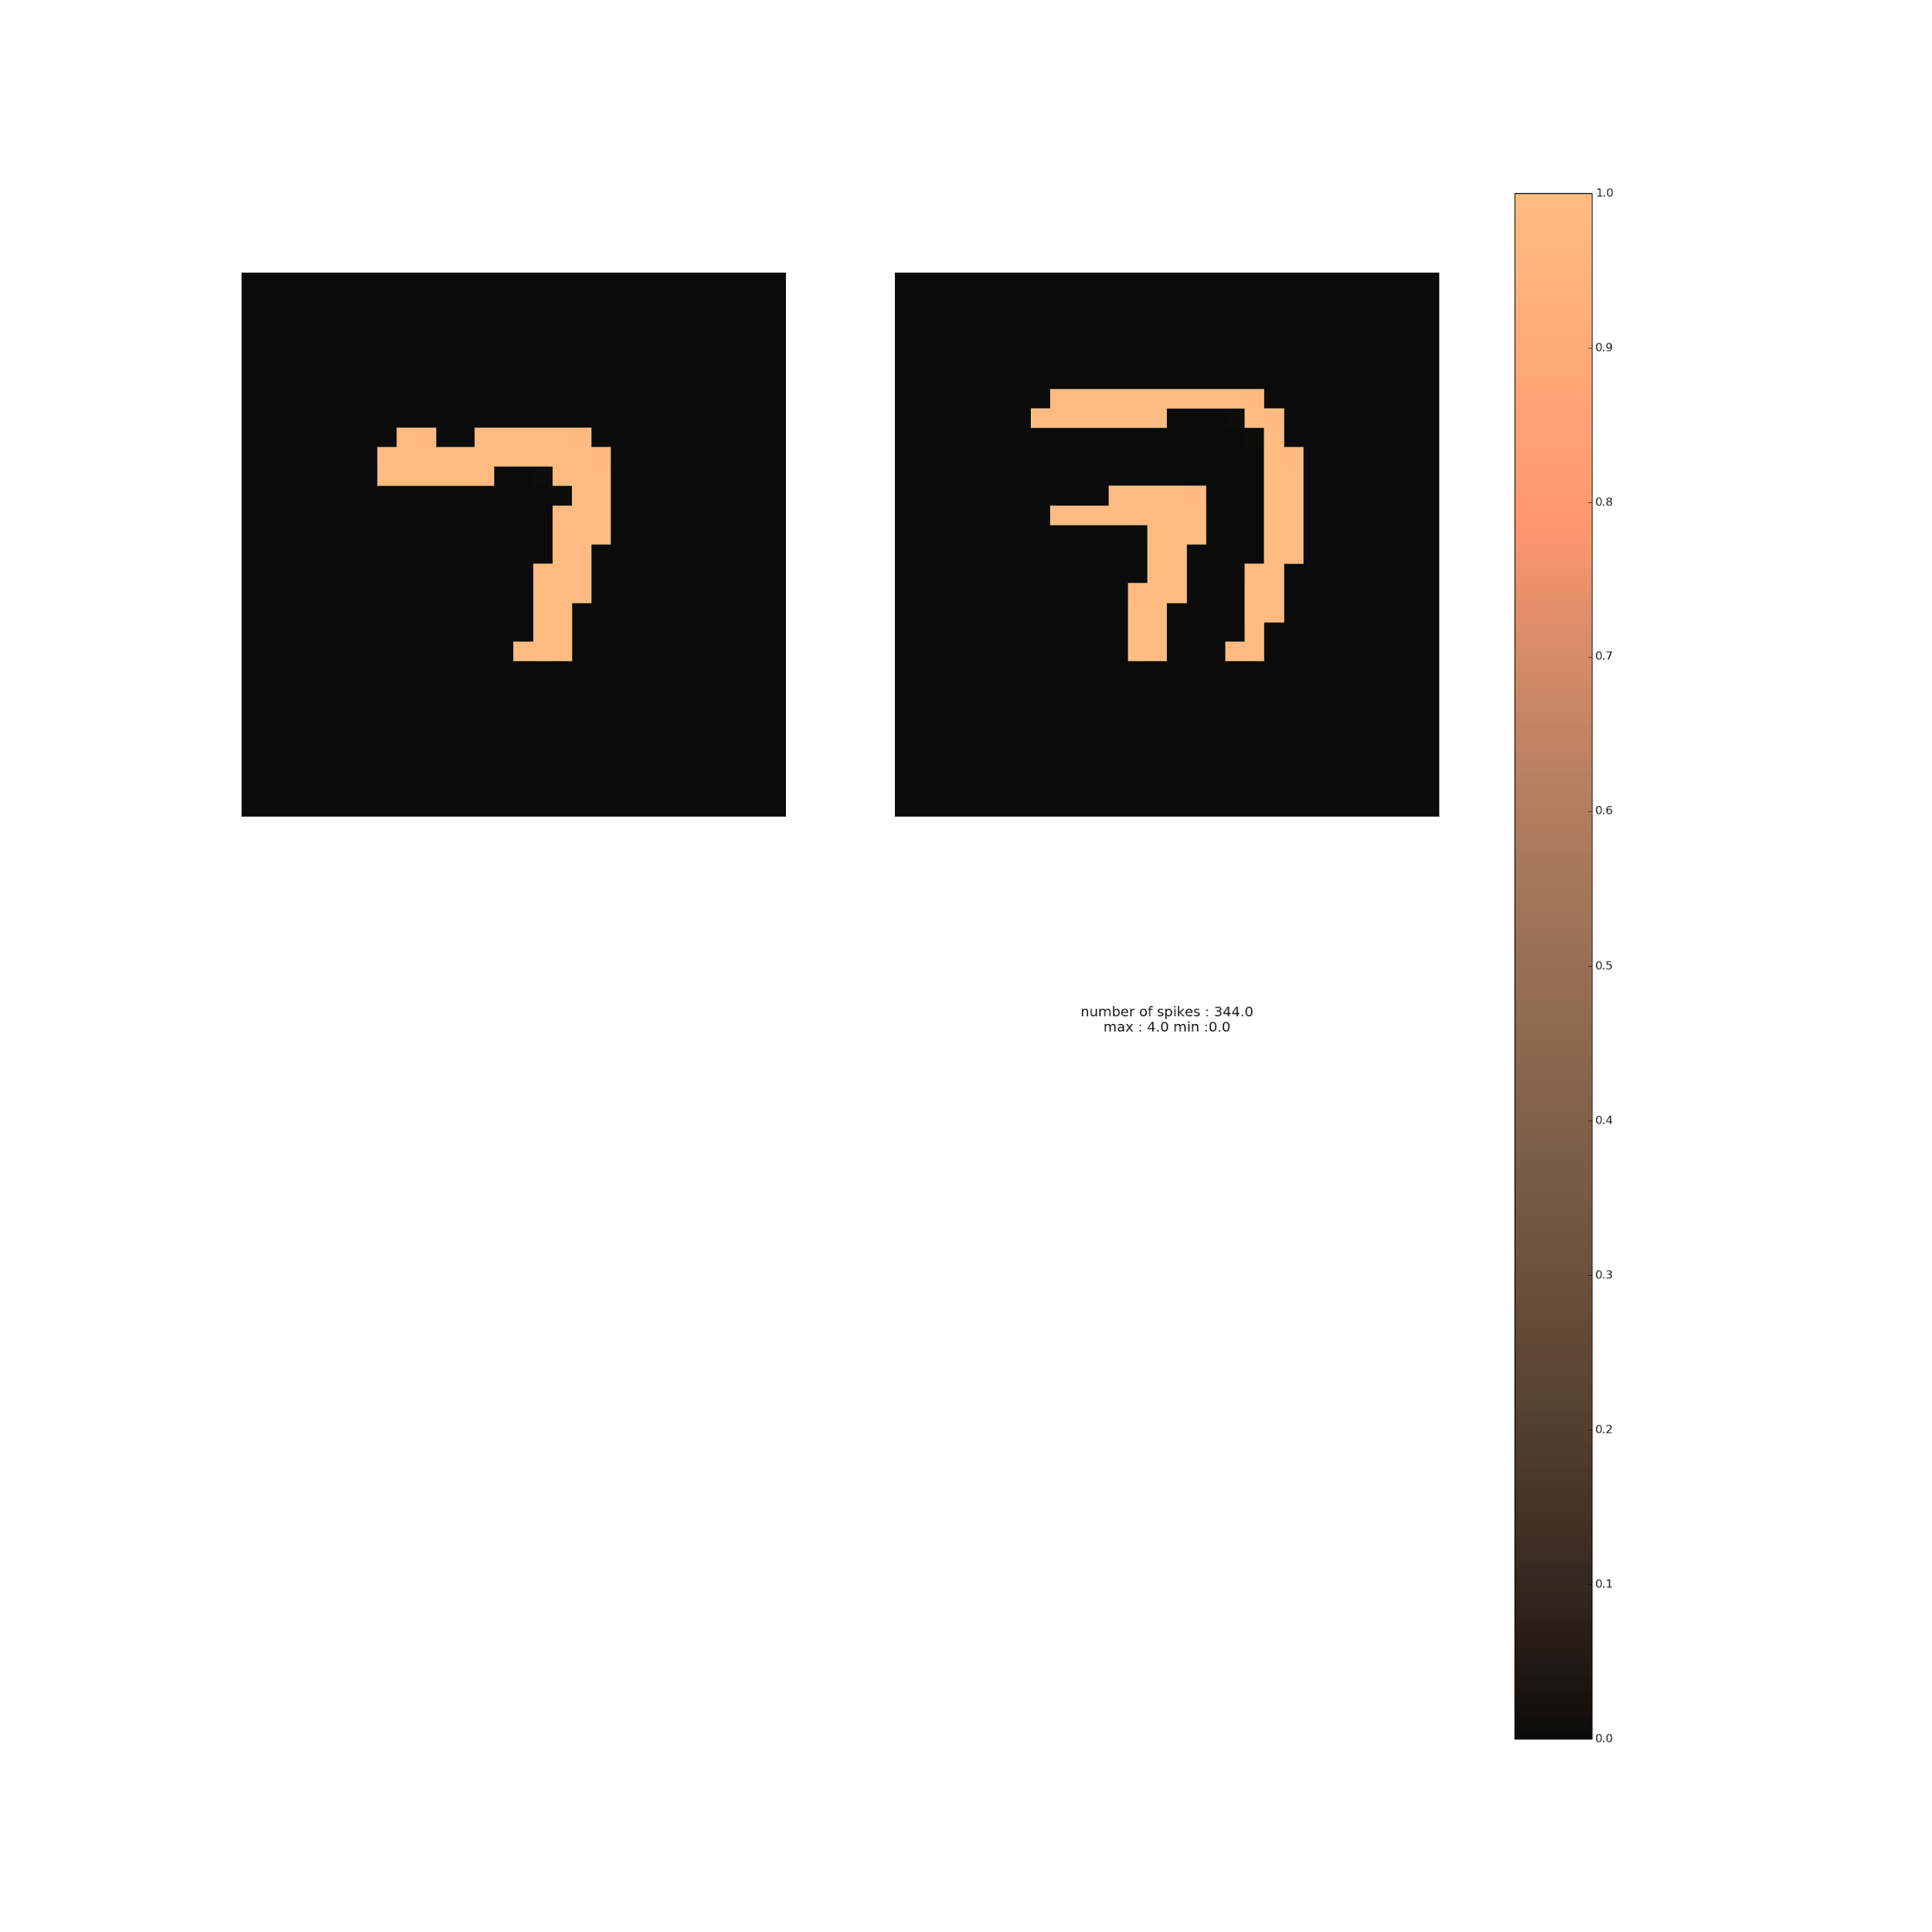
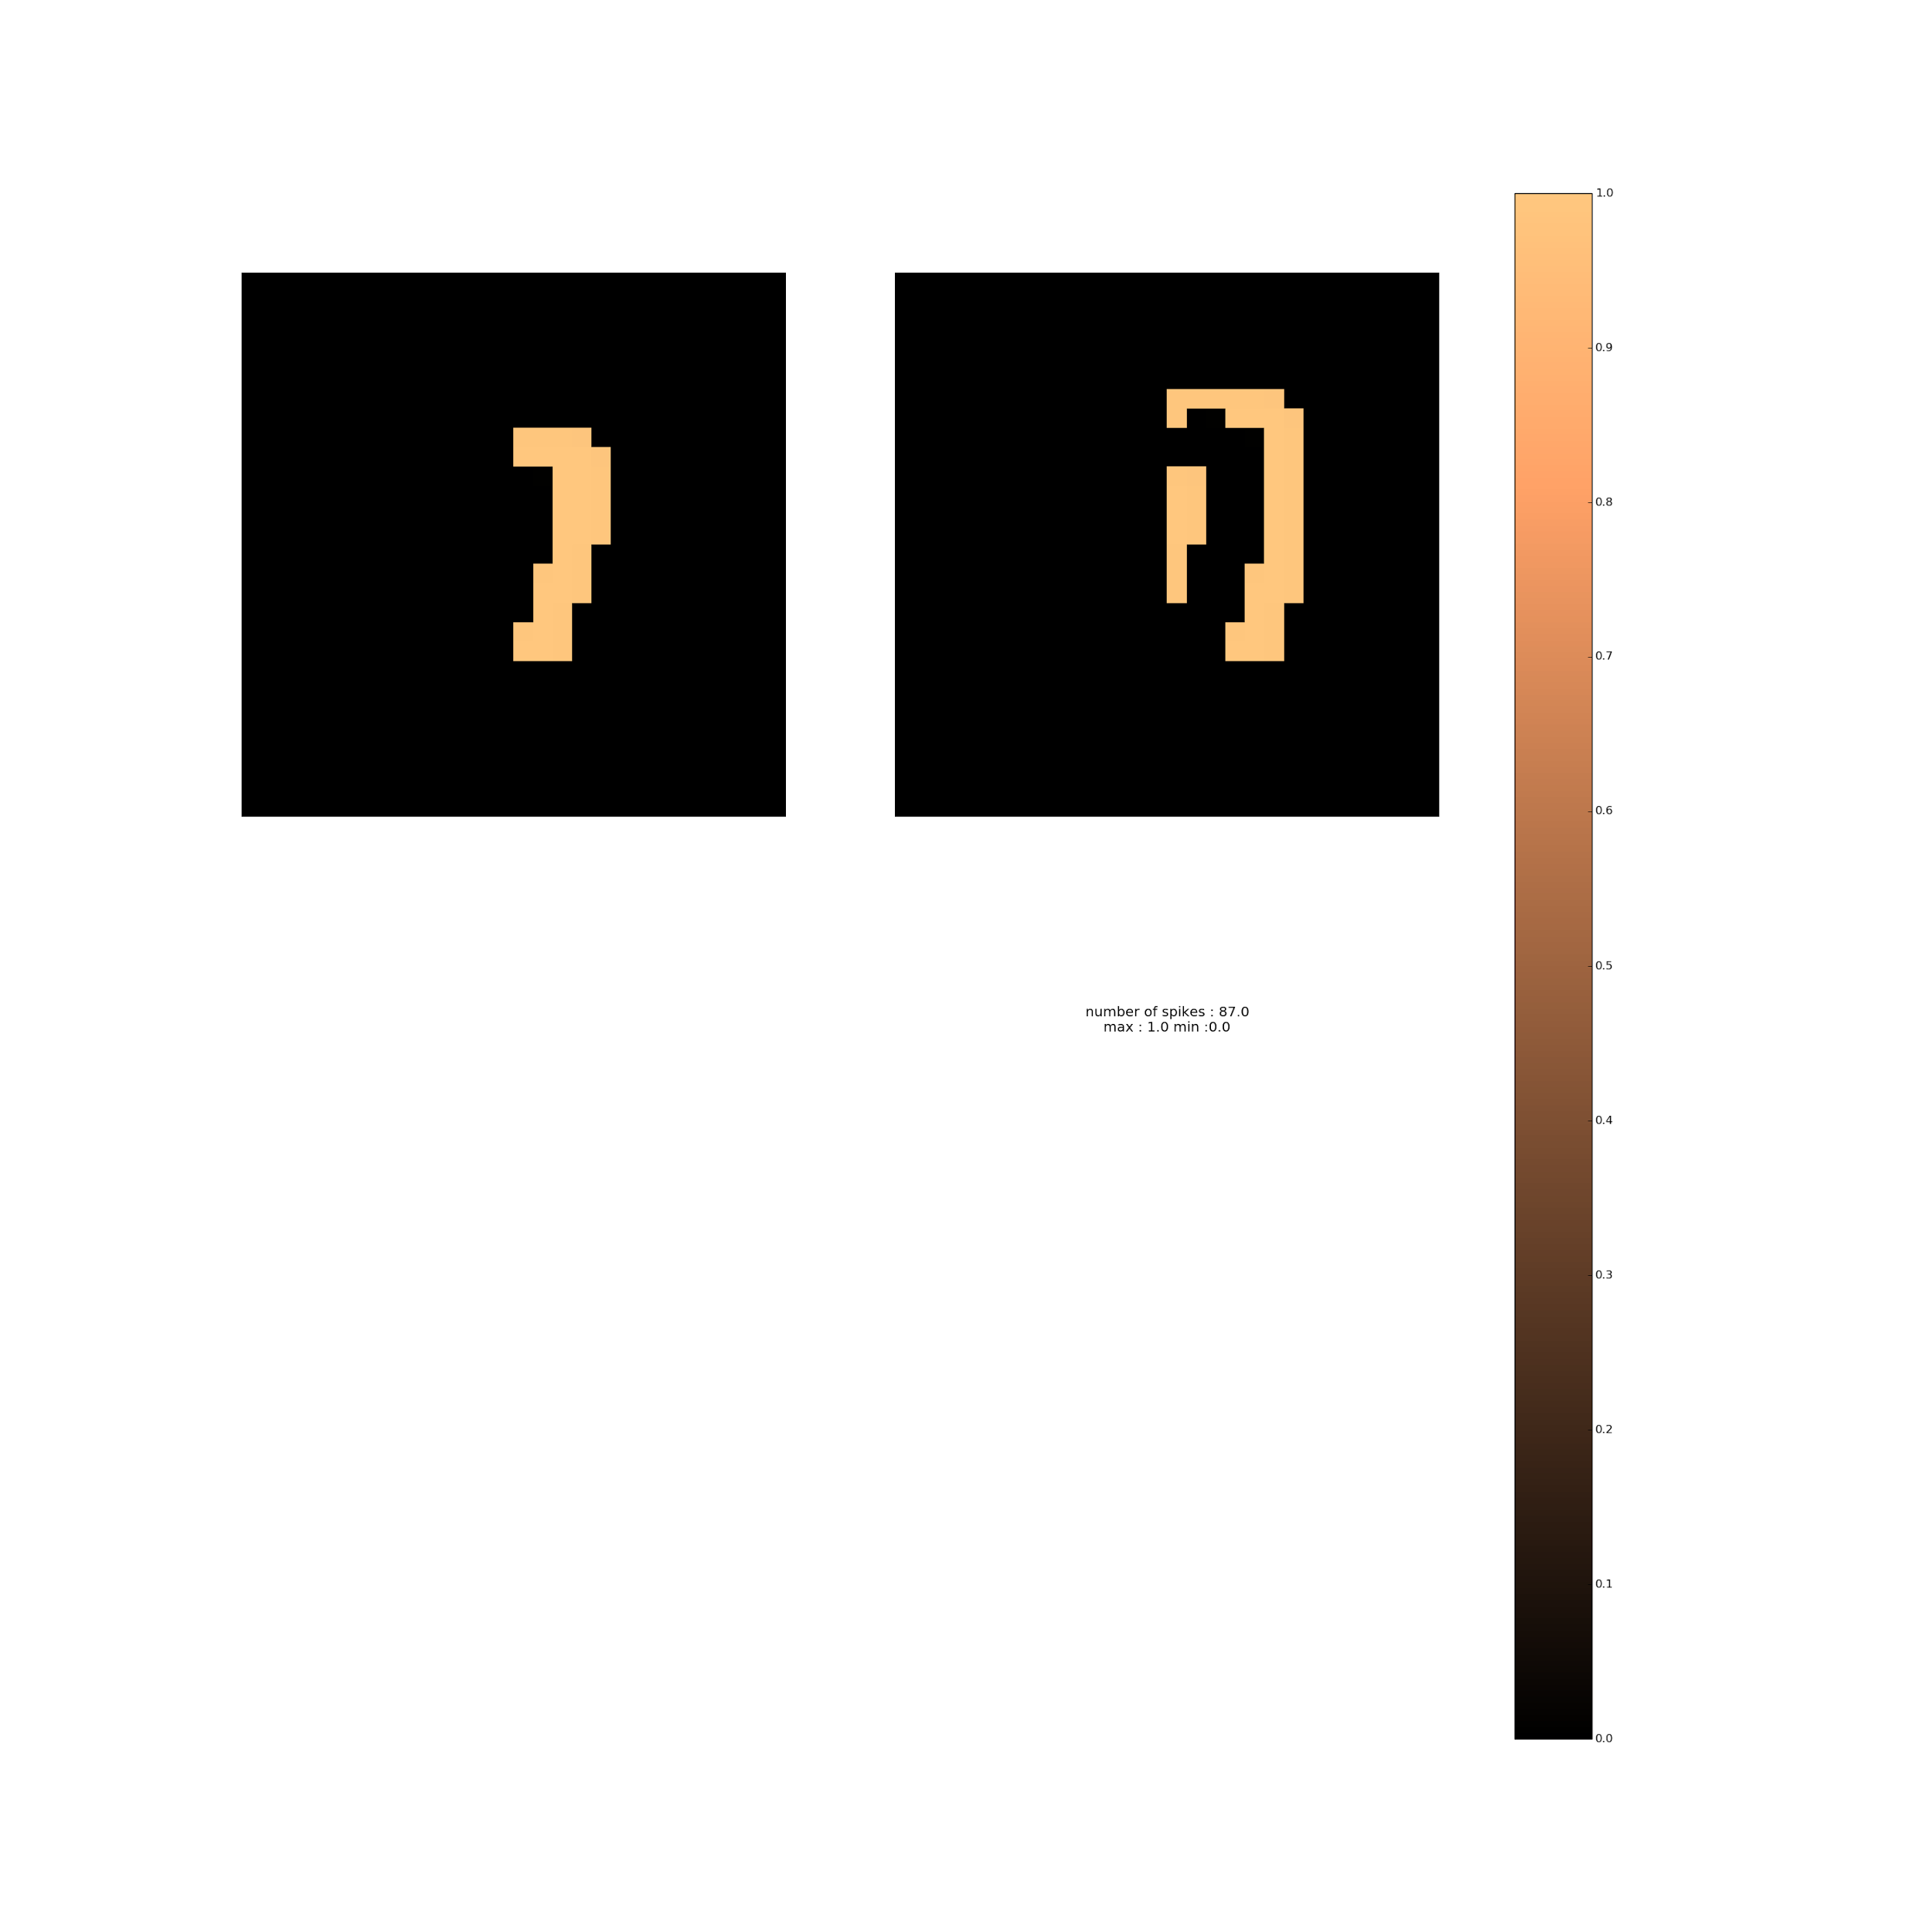

Slide 26
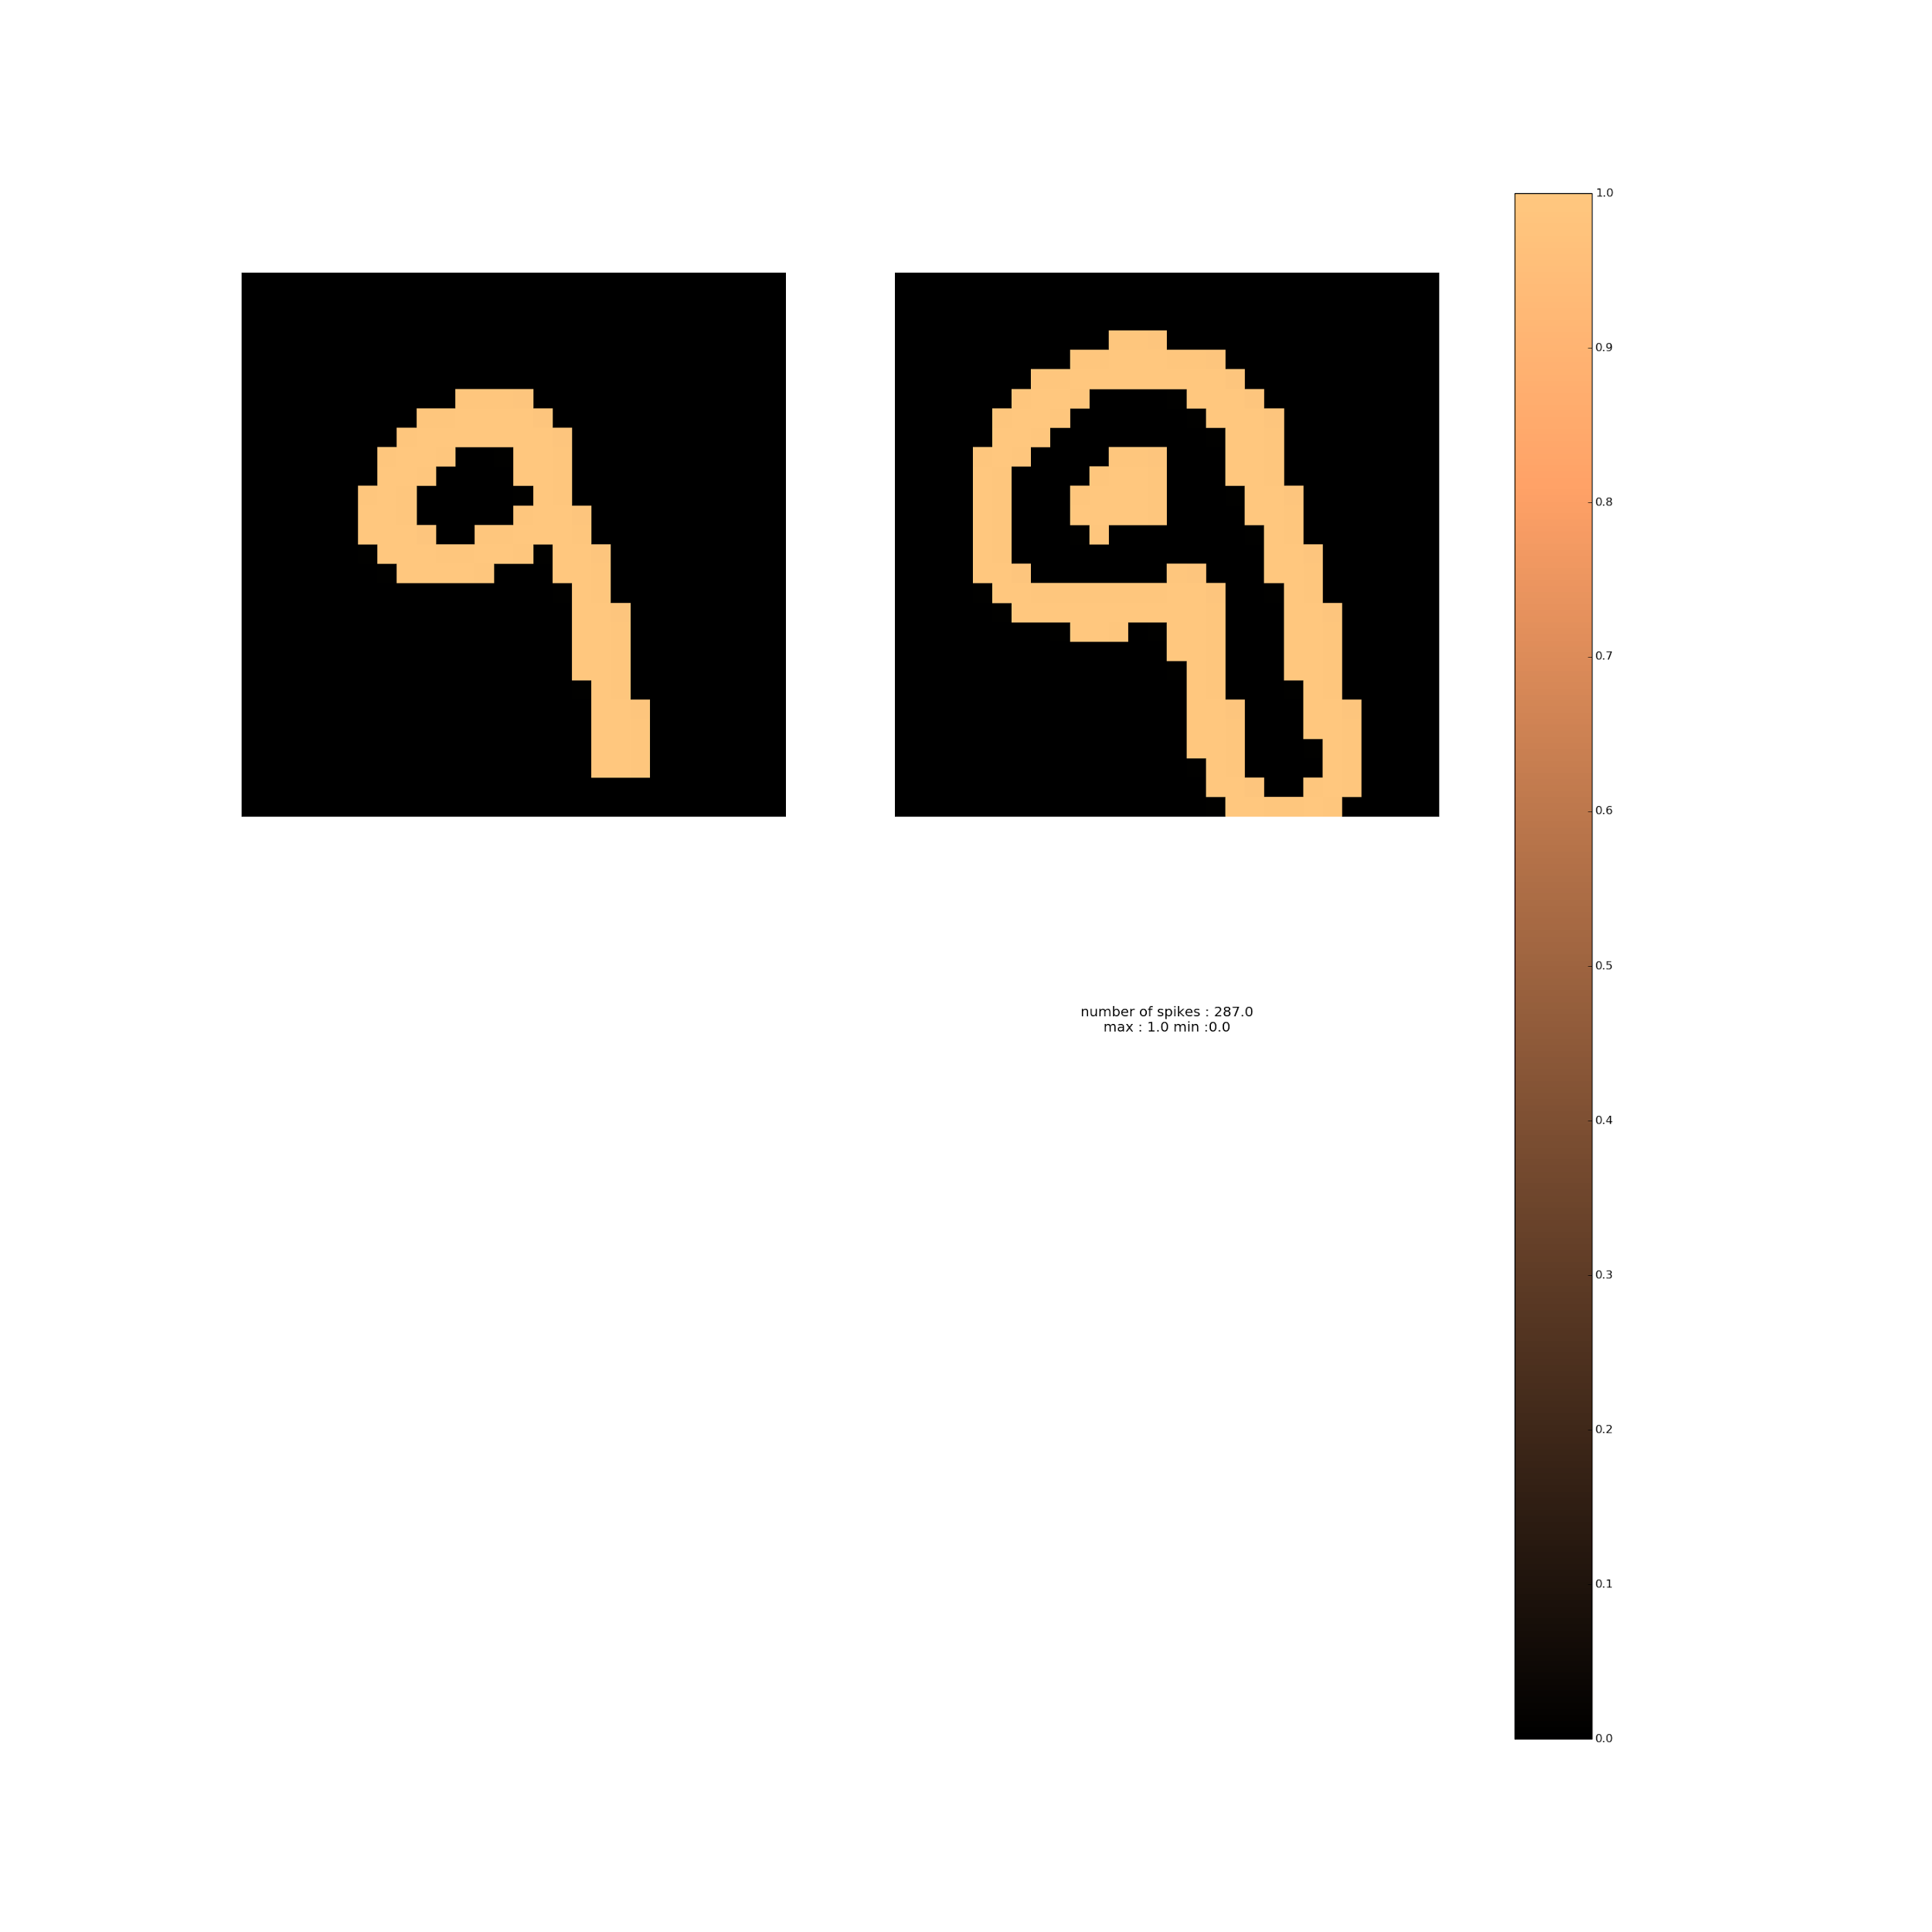
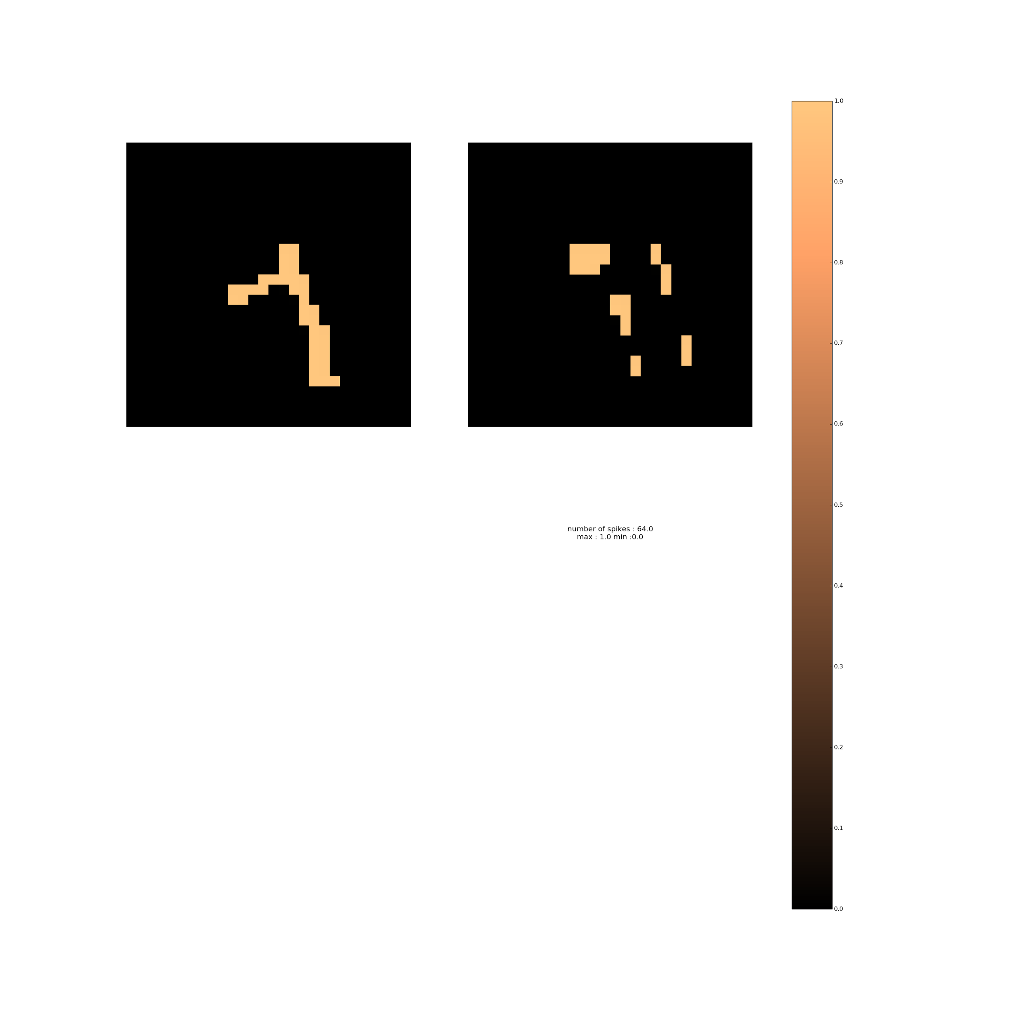

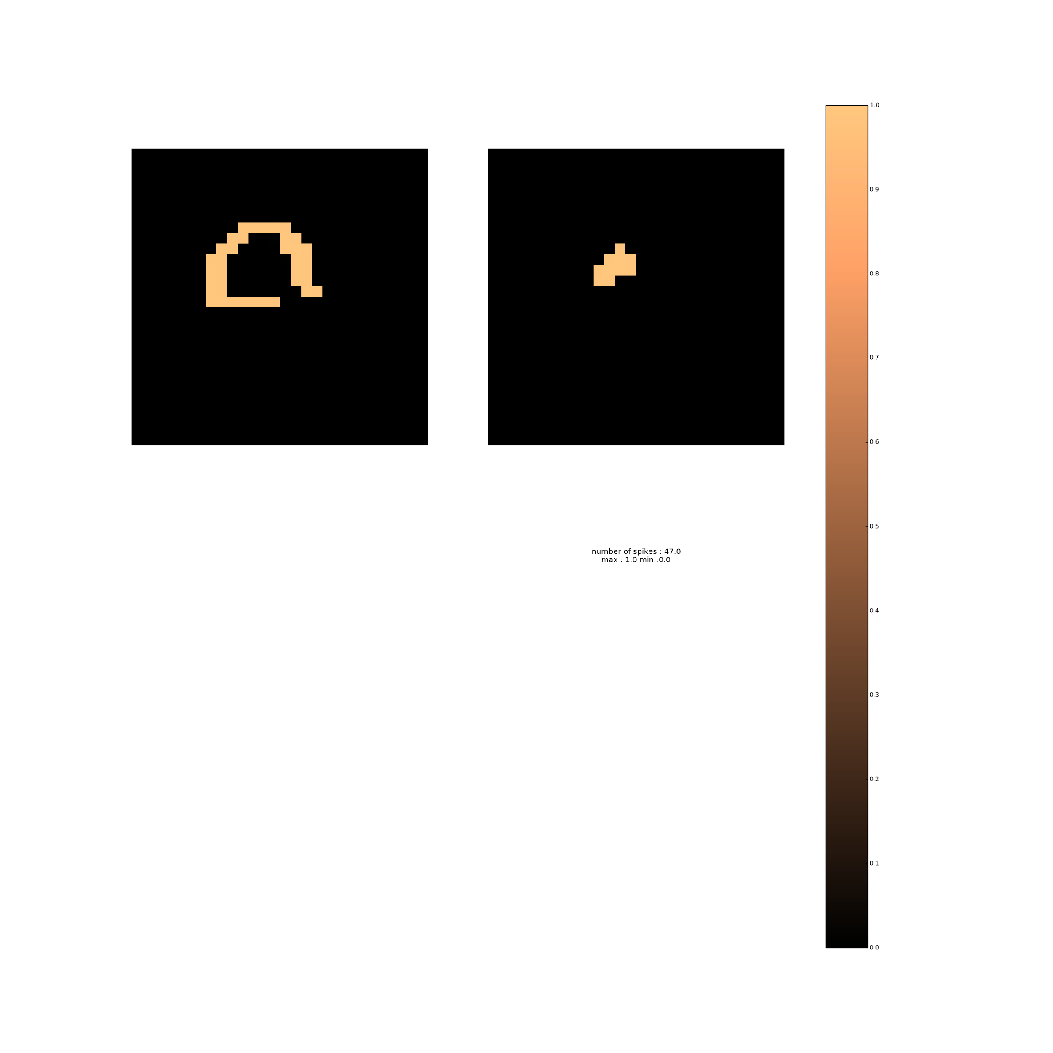
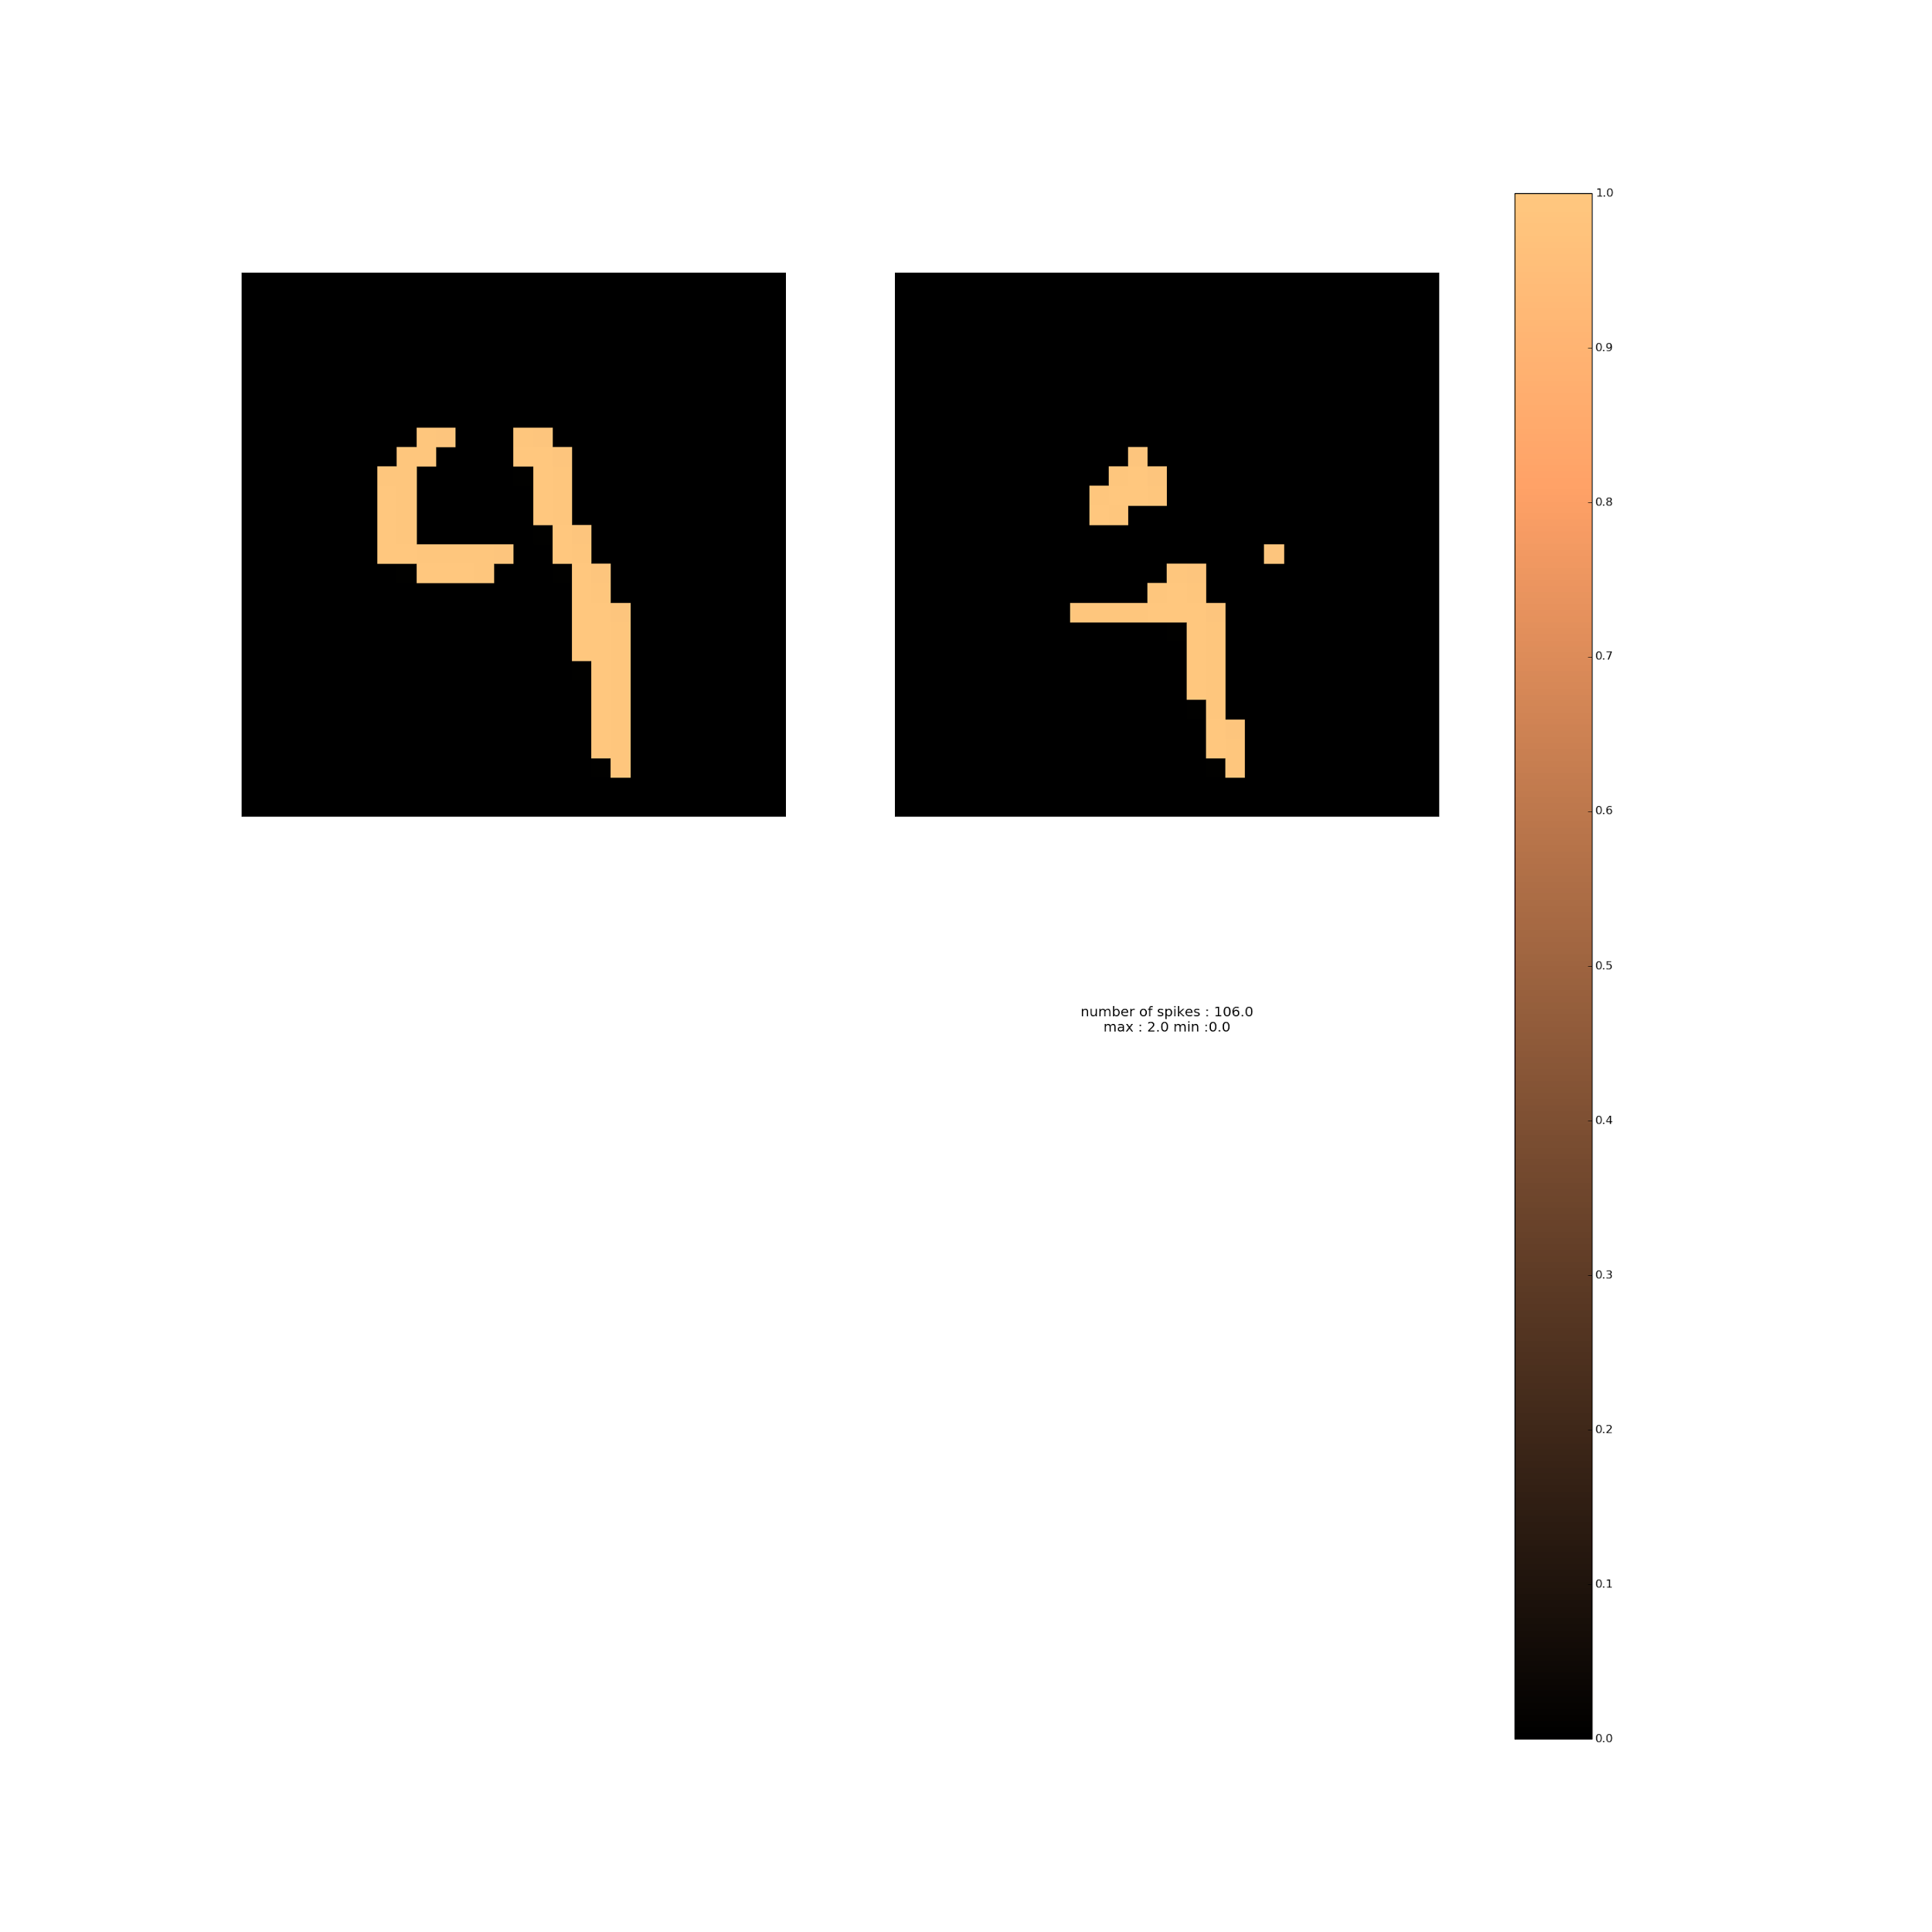
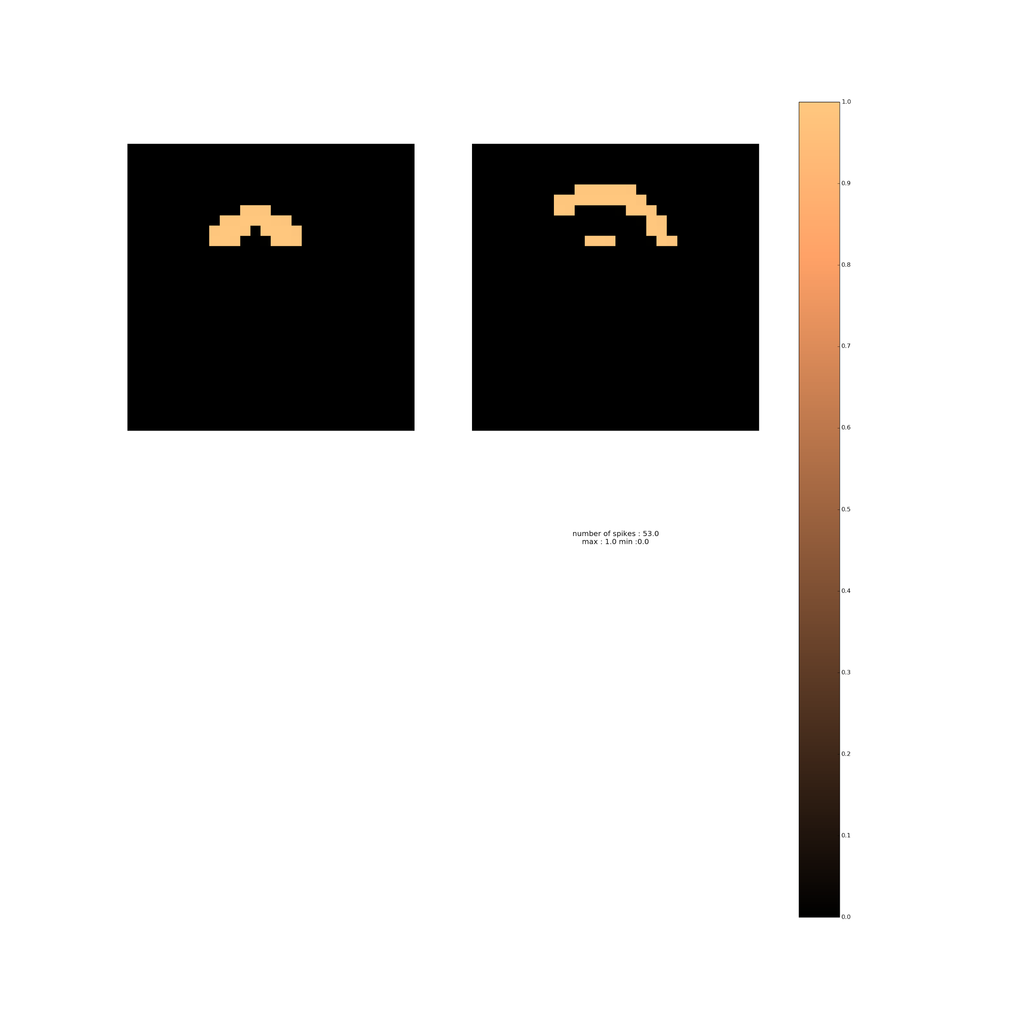

Slide 27
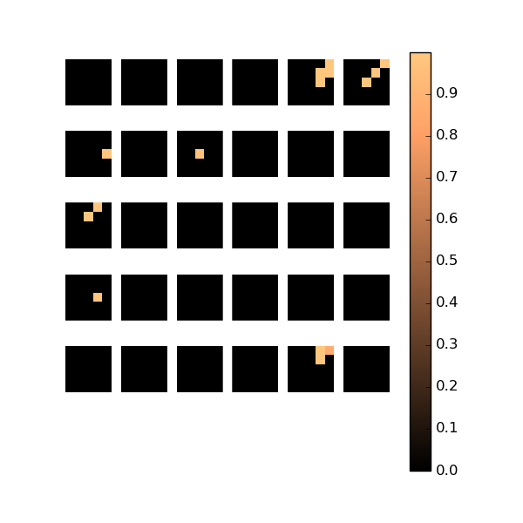

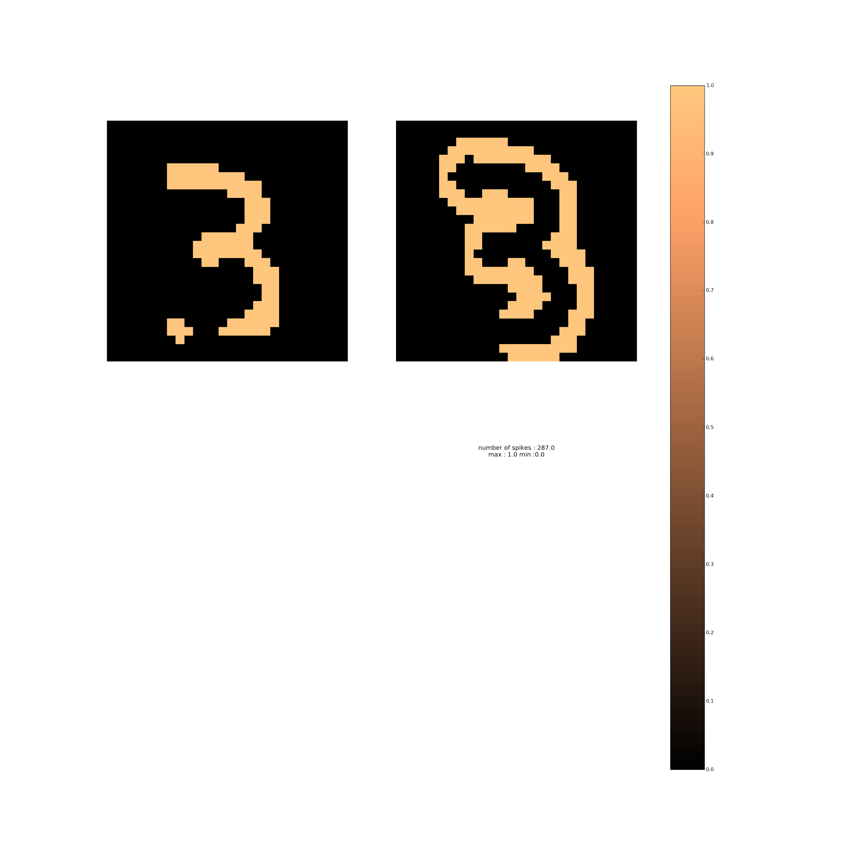
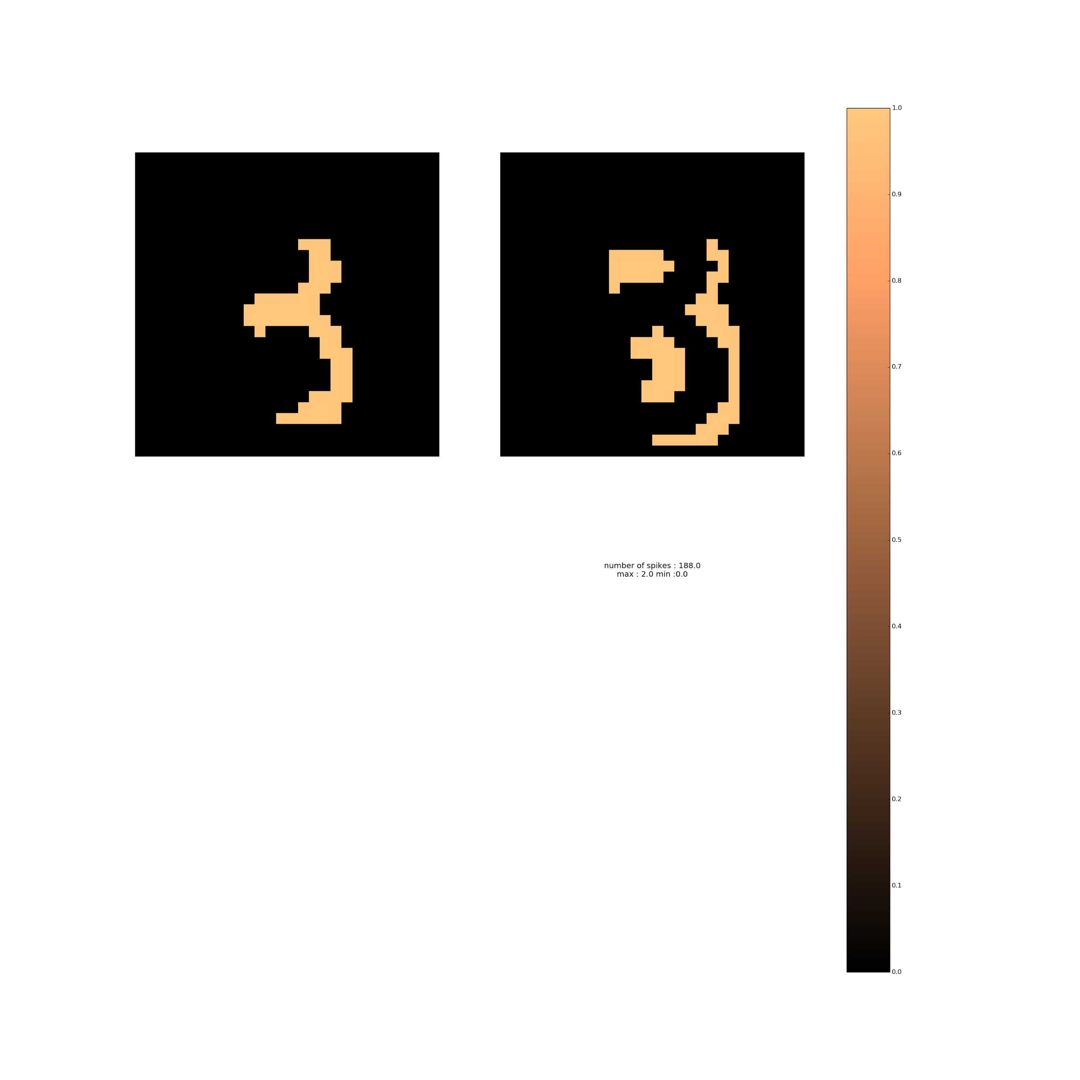
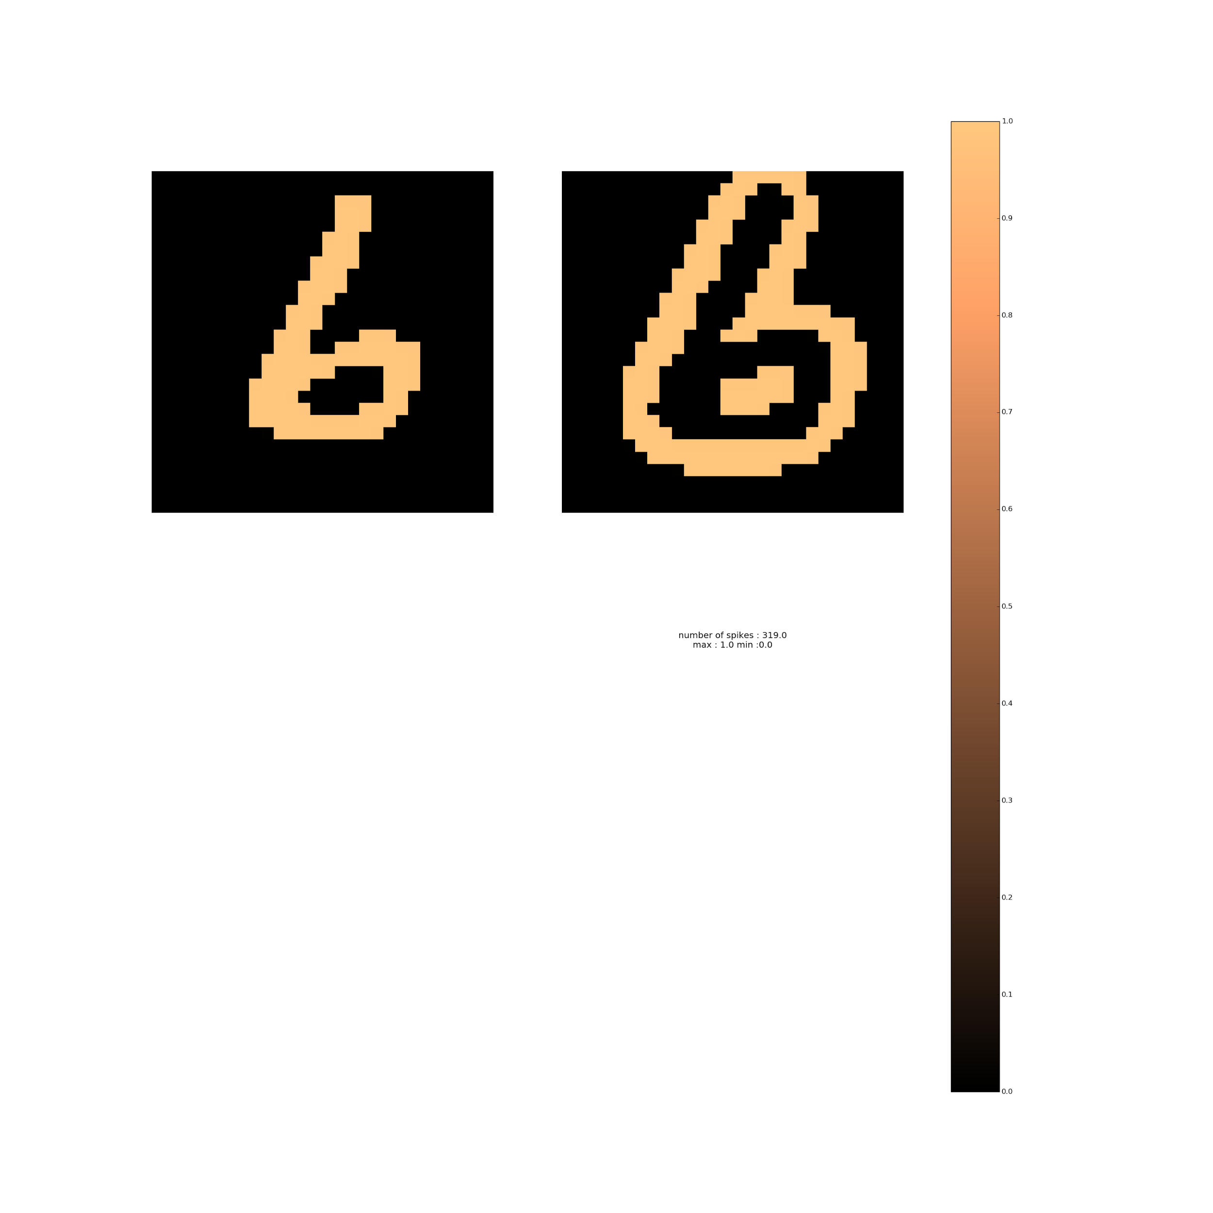
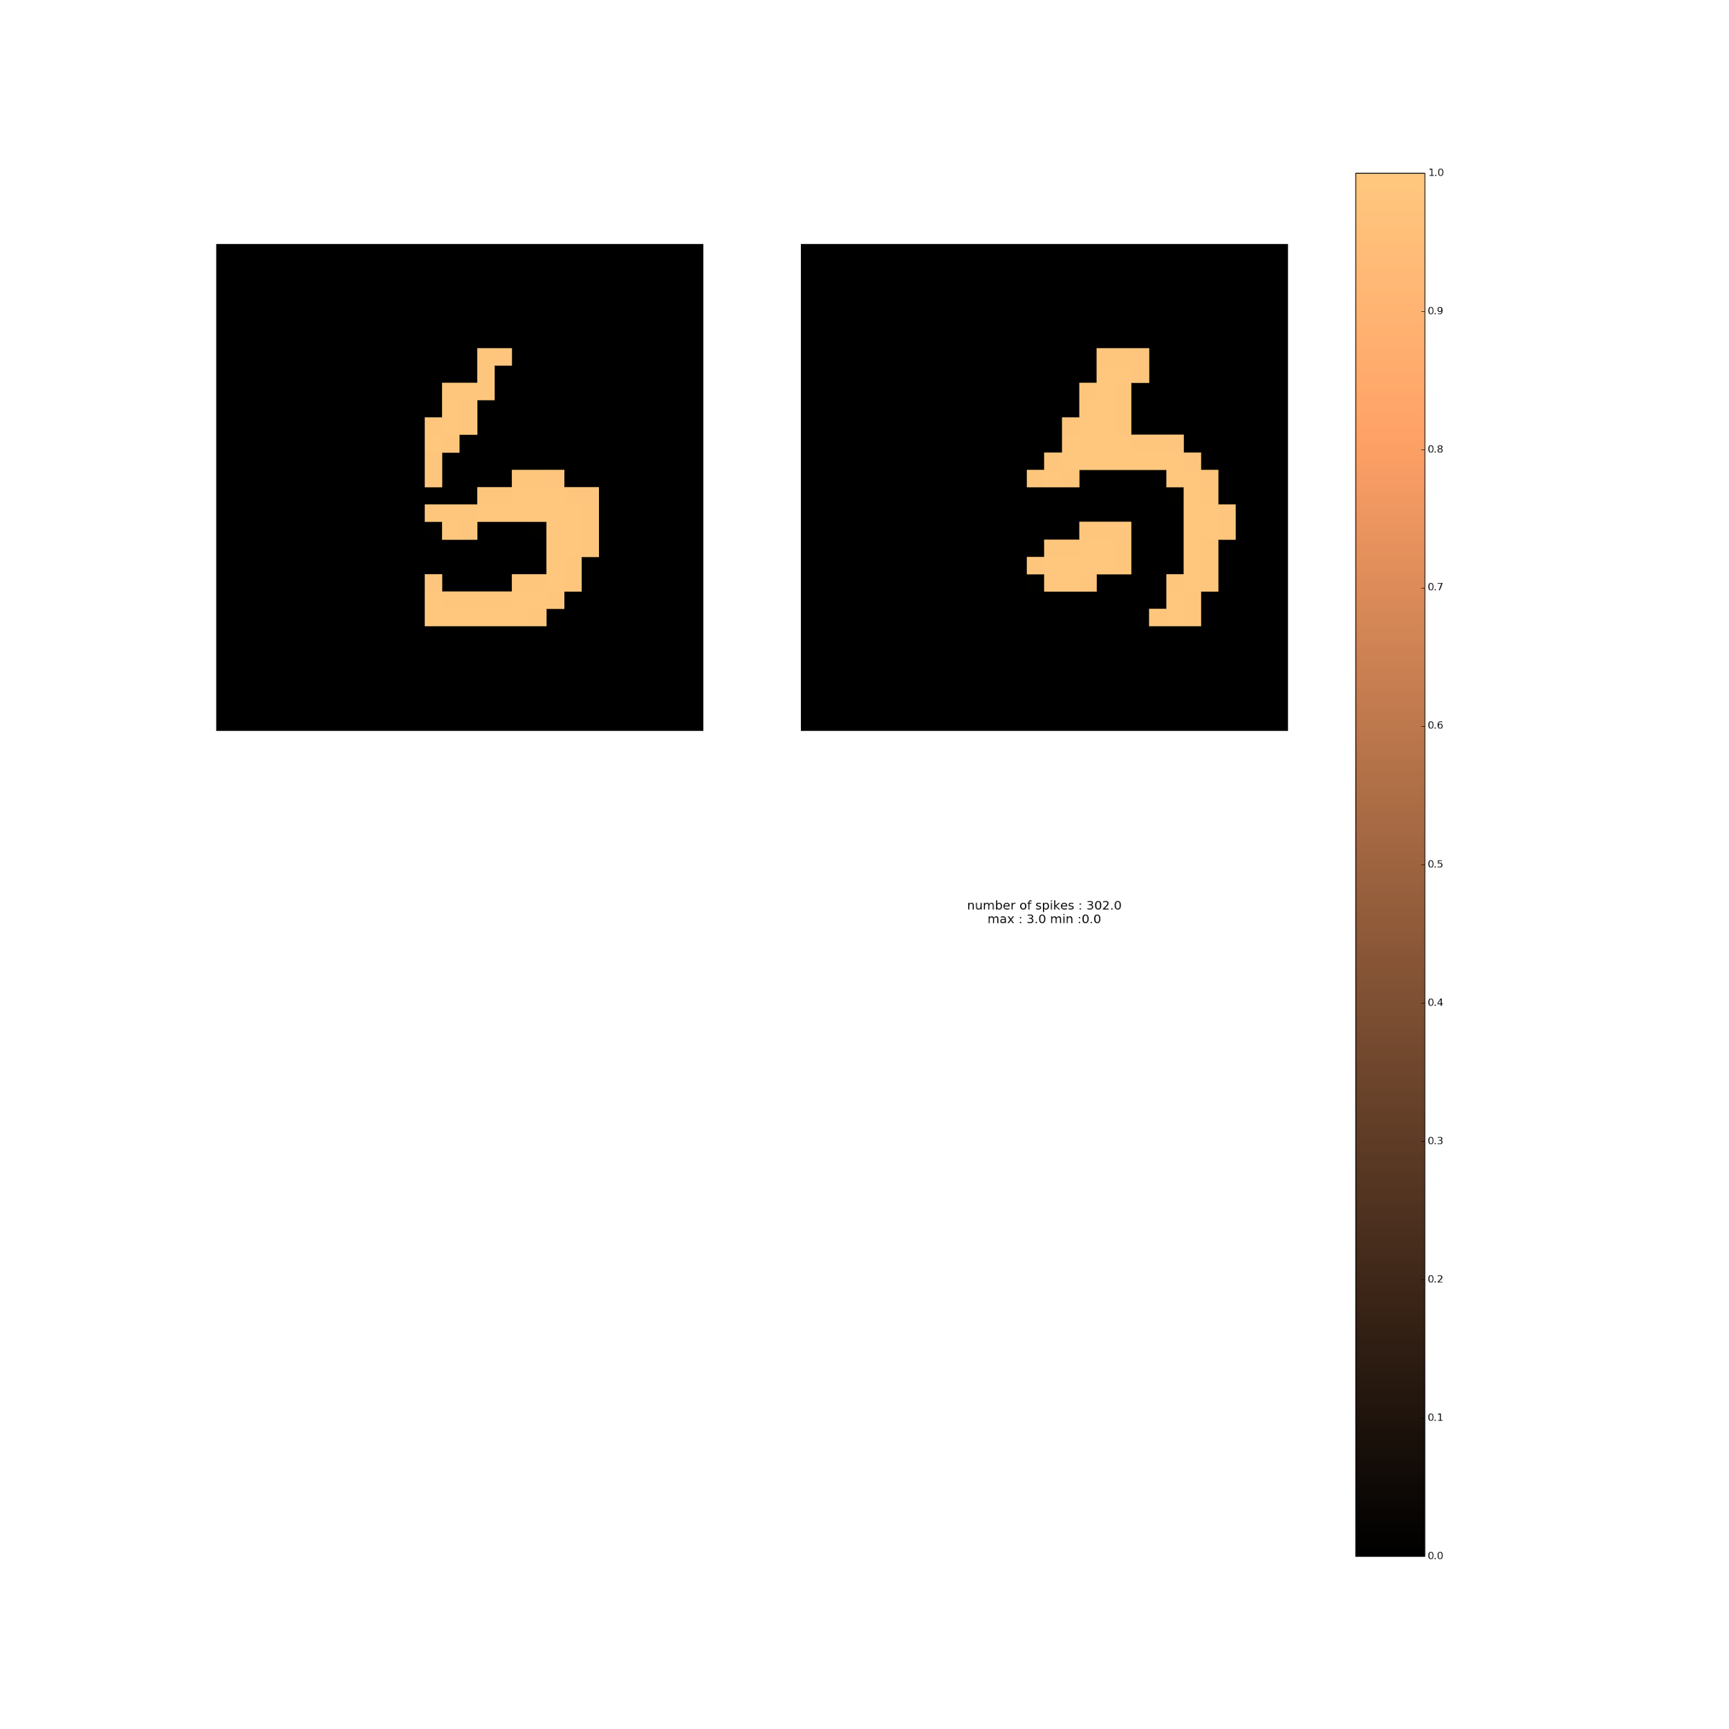
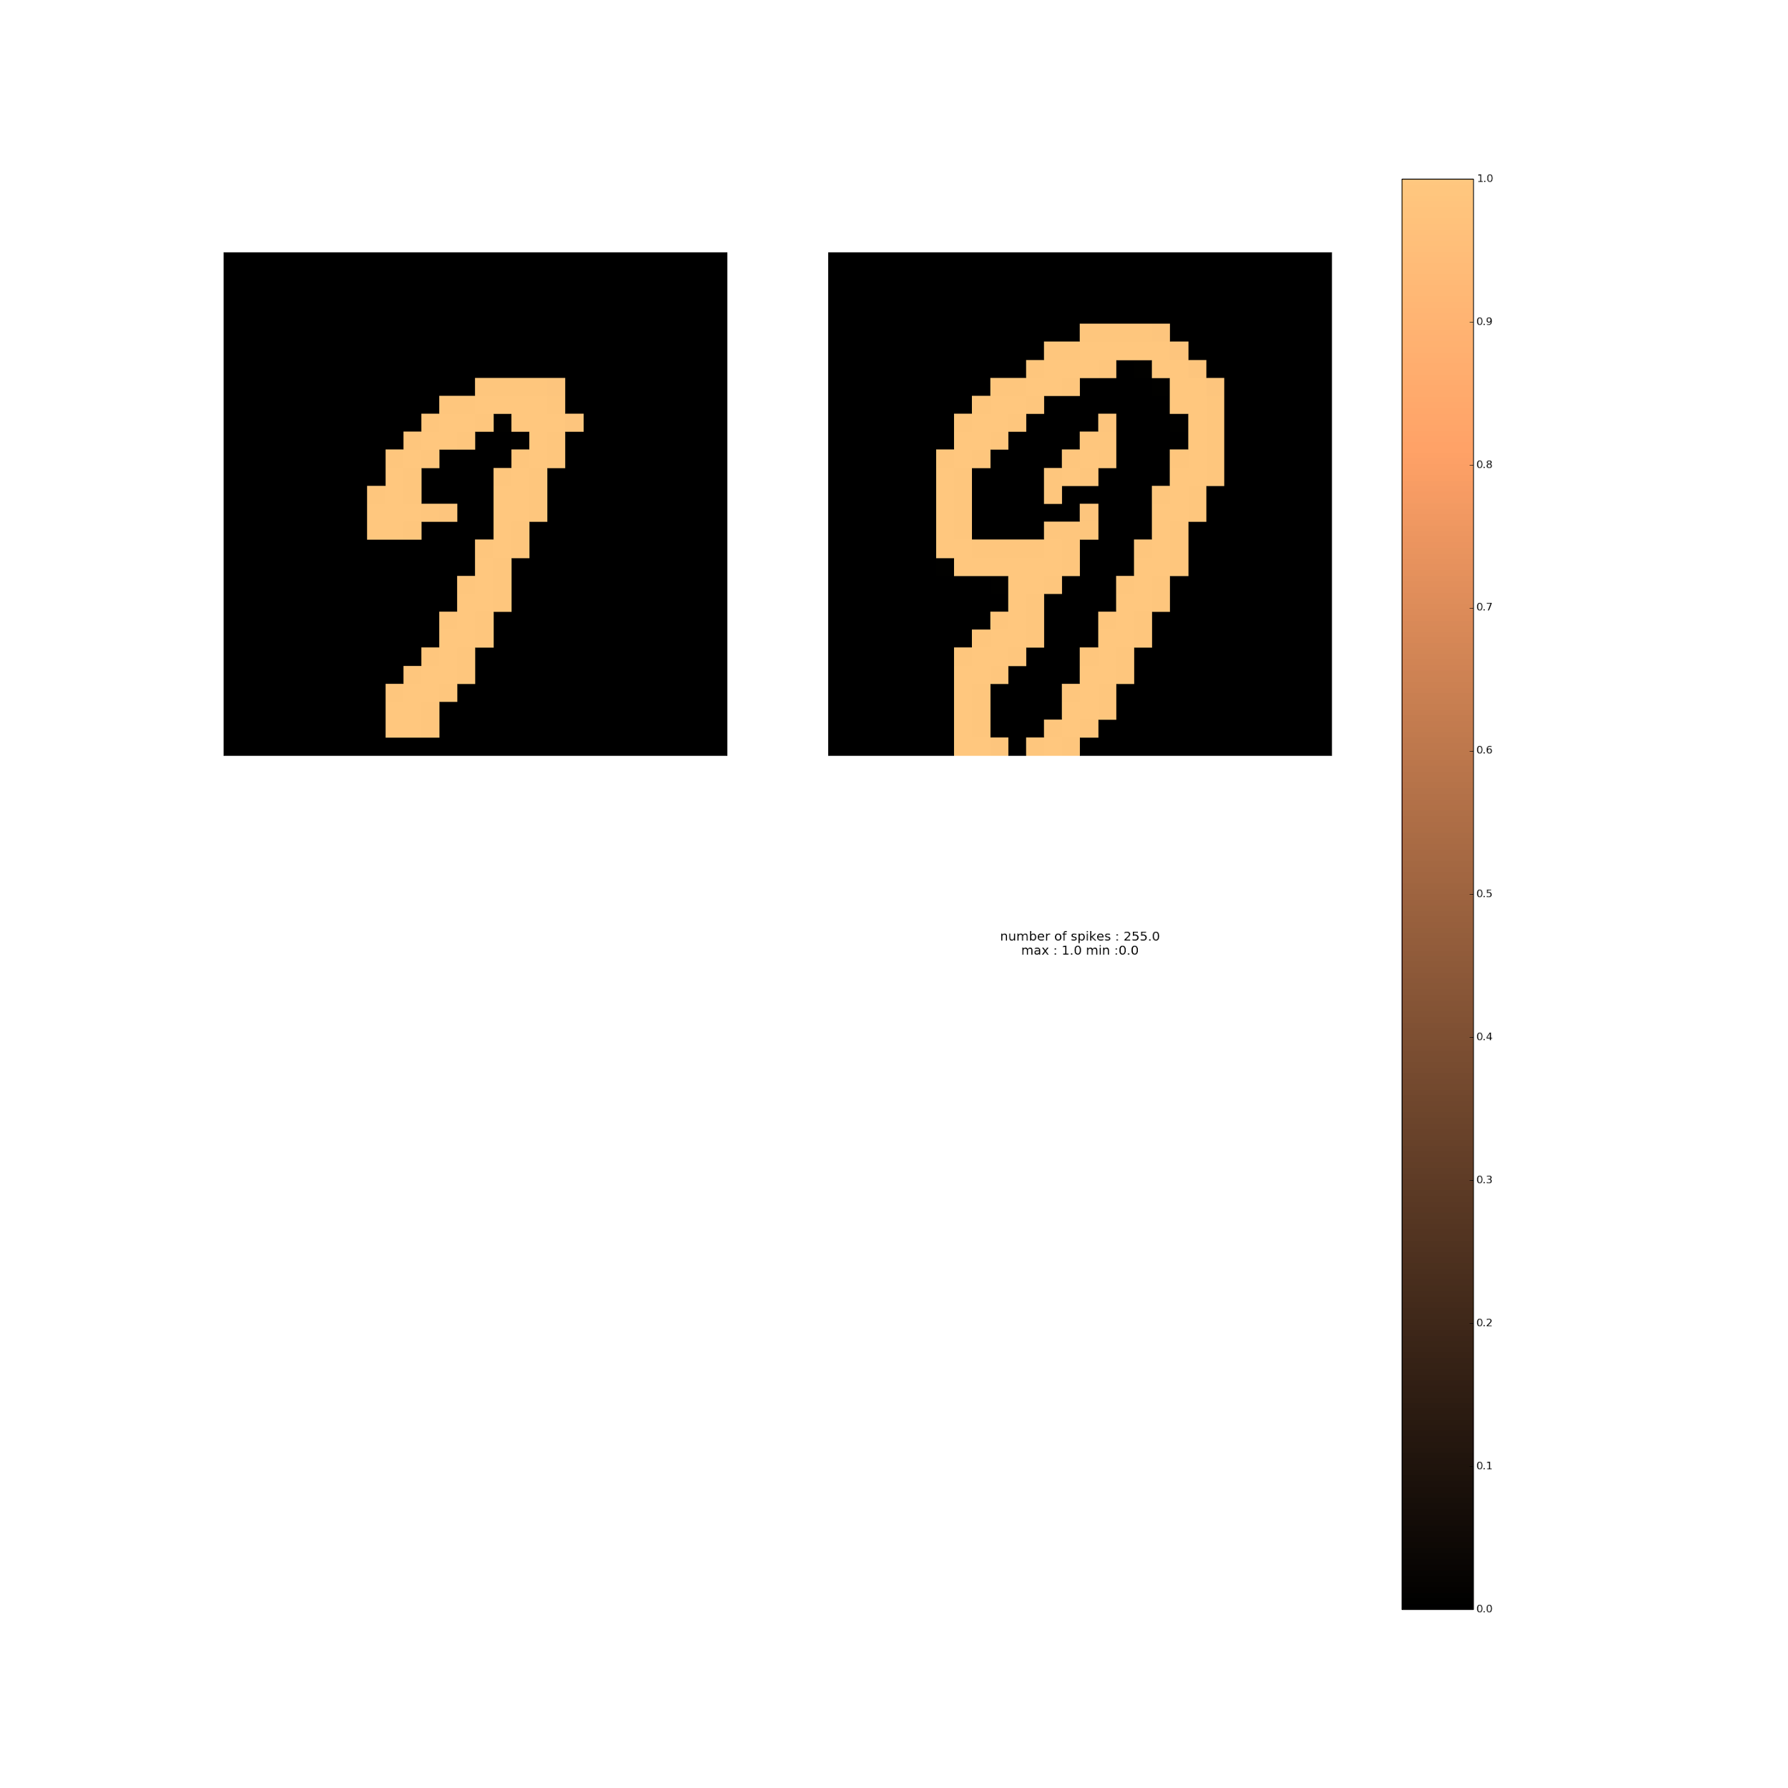
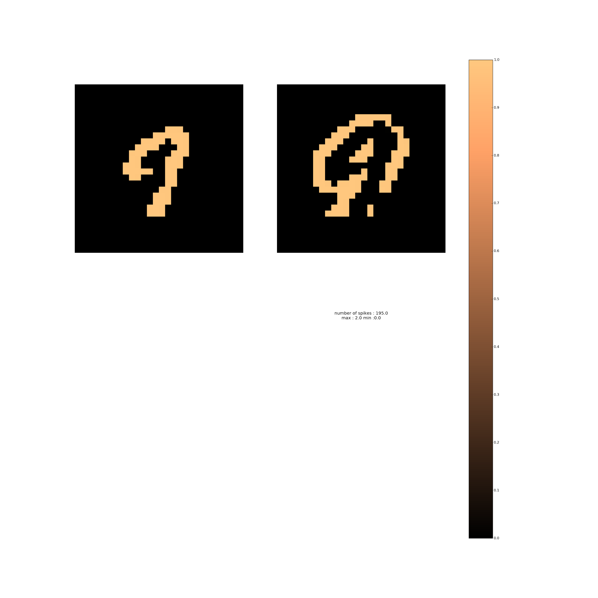
Deconv of a particular filter

Slide 28
RESULTS
Batch Size : 1
 | Layer Type | Threshold | Number of filters | Filter Size | Stride for pool Layer
Conv1 | snn_convlayer | 15 | 30 | 5 | -
Pool1 | snn_poolLayer | - | - | 2 | 2
Conv2 | snn_convlayer | 10 | 100 | 5 | -
Accuracy : | 93.78%

Slide 29
RESULTS
Batch Size : 4
ARCHITECTURE :
 | Layer Type | Threshold | Number of filters | Filter Size | Stride for pool Layer
Conv1 | snn_convlayer | 15 | 30 | 5 | -
Pool1 | snn_poolLayer | - | - | 2 | 2
Conv2 | snn_convlayer | 10 | 100 | 5 | -
Accuracy : | 96.11%

Slide 30
RESULTS
ARCHITECTURE :
Batch Size : 4
 | Layer Type | Threshold | Number of filters | Filter Size | Stride for pool Layer
Conv1 | snn_convlayer | 15 | 30 | 5 | -
Pool1 | snn_poolLayer | - | - | 2 | 2
Conv2 | snn_convlayer | 20 | 100 | 5 | -
Accuracy : | 97.26%

Slide 31
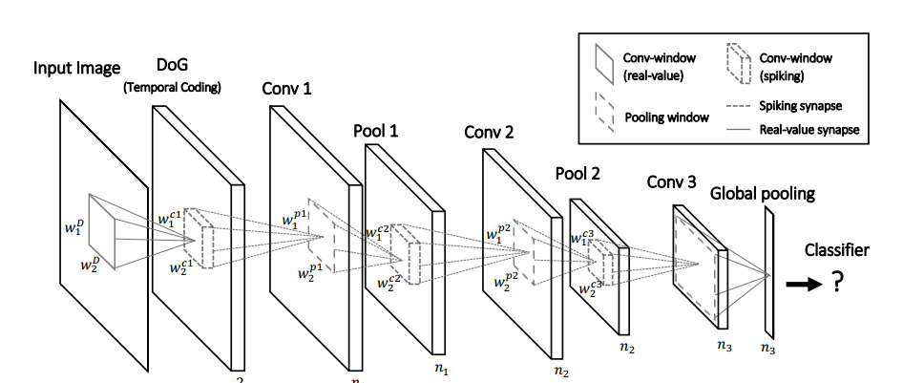
CALTECH - FACE, BIKE

Slide 32
RESULTS
 | Layer Type | Threshold | Number of filters | Filter Size | Stride for pool Layer
Conv1 | snn_convlayer | 10 | 4 | 5 | -
Pool1 | snn_poolLayer | - | - | 7 | 6
Conv2 | snn_convlayer | 60 | 20 | 15 | -
Pool2 | snn_poolLayer | - | - | 2 | 2
Conv3 | snn_convlayer | 2 | 10 | 5 | -
Accuracy : | 96.40%

Slide 33

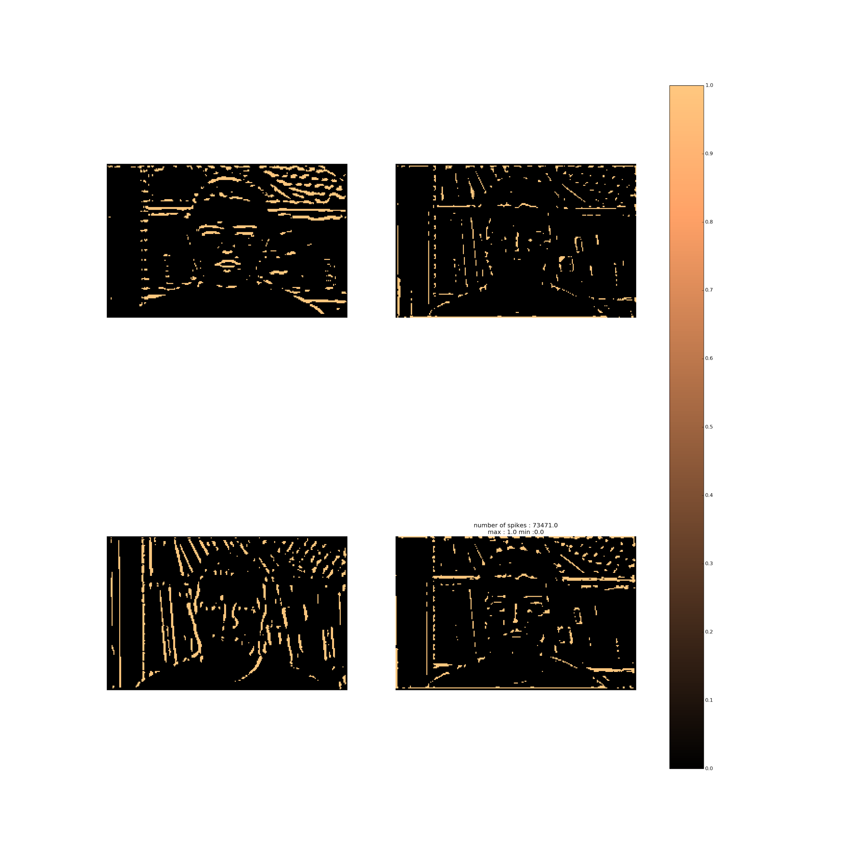
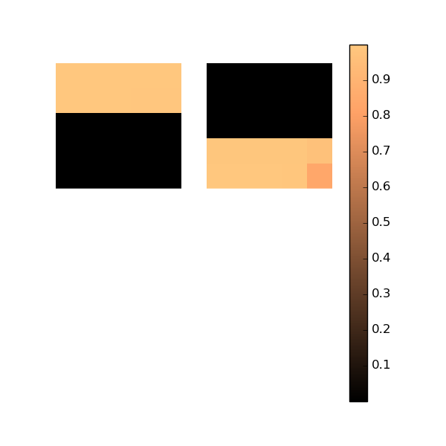
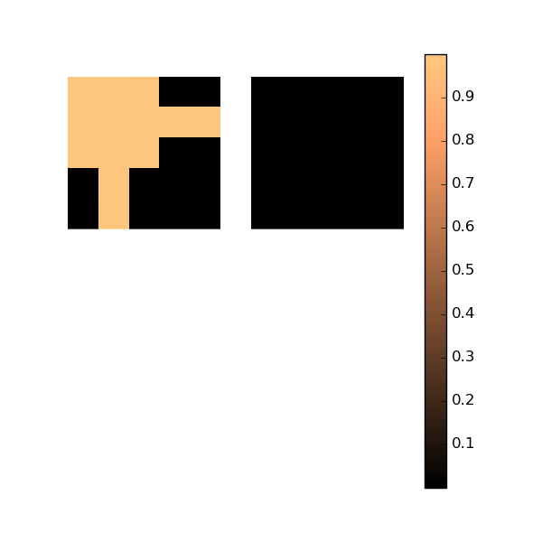
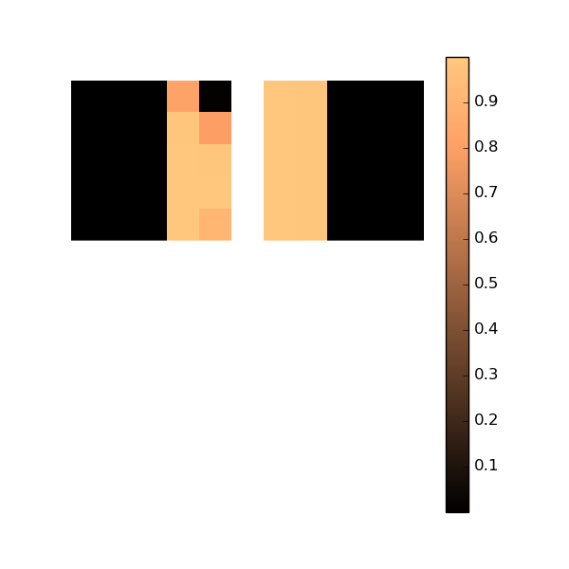
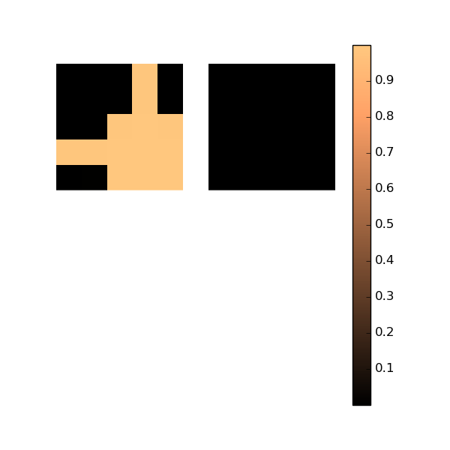
CONV1
Number of filters :4
Threshold : 10
Trained weights
Corresponding activations

Slide 34
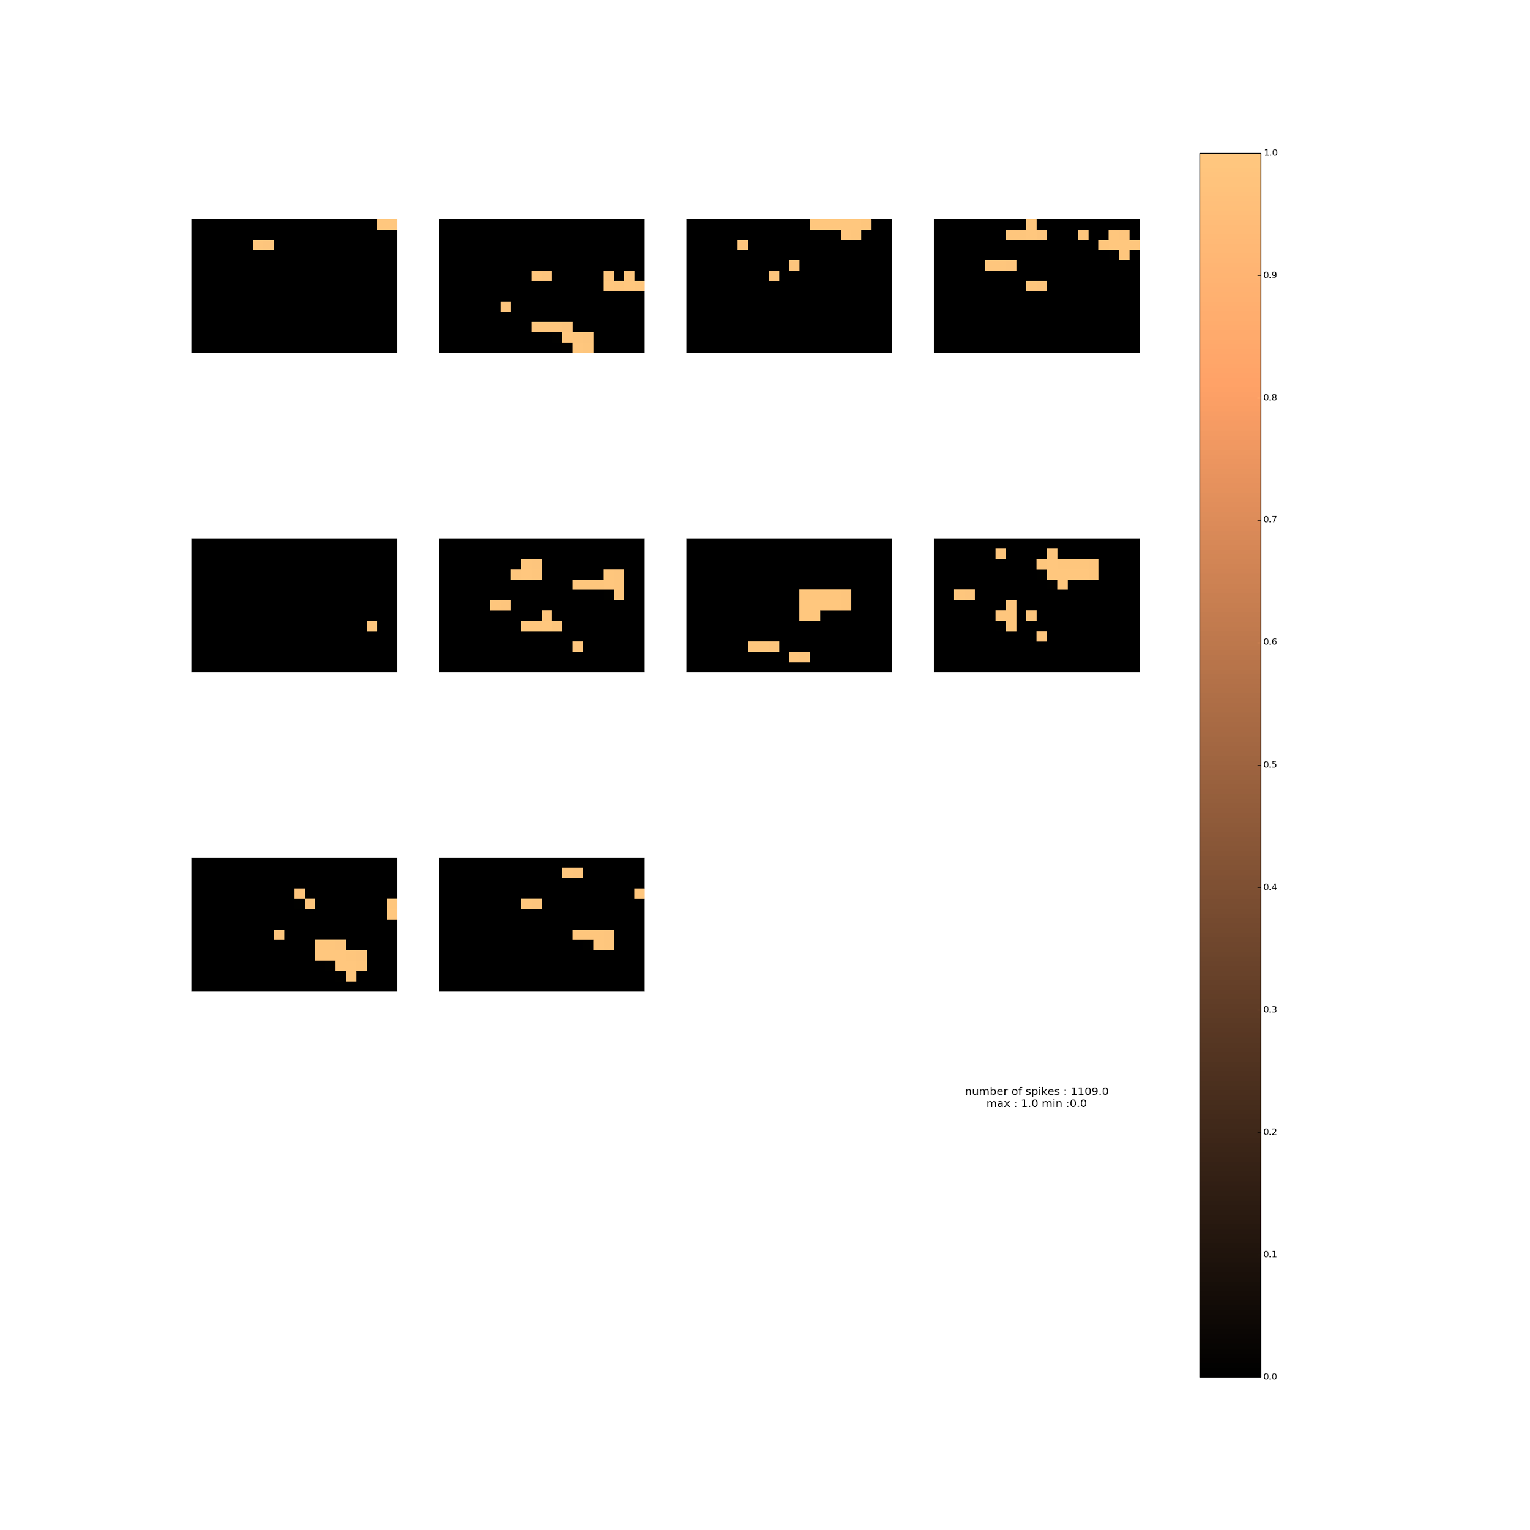
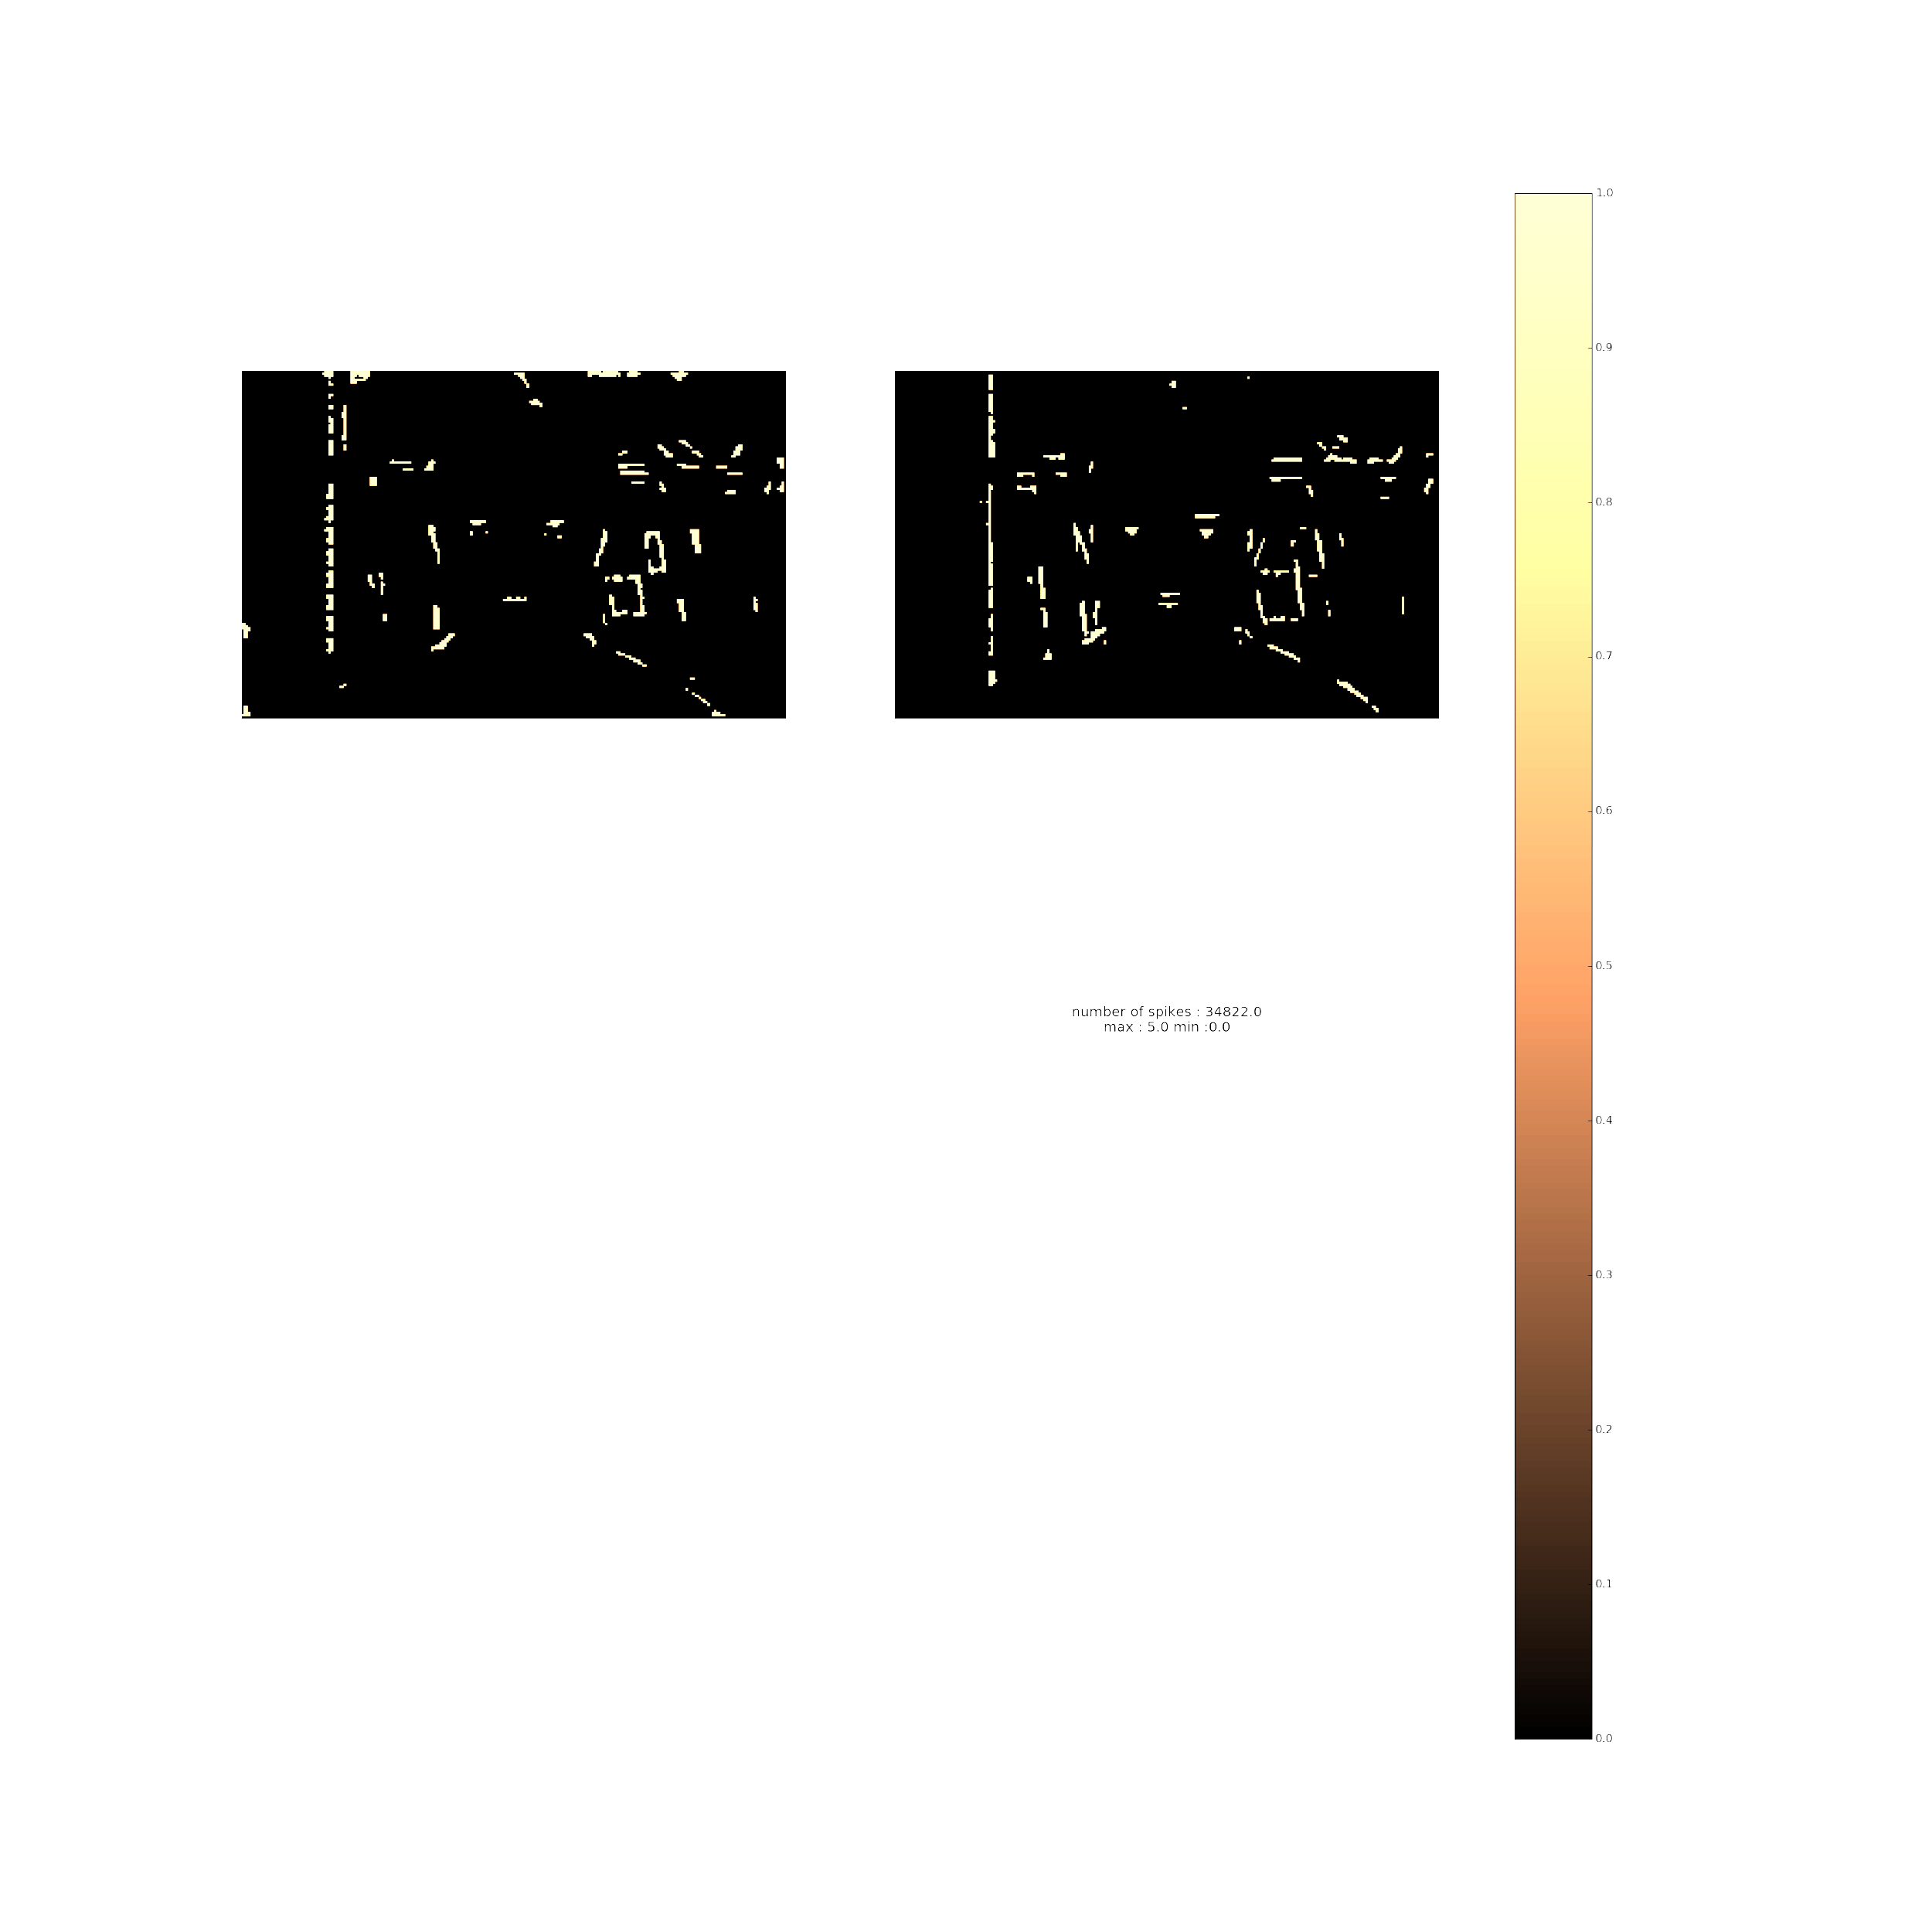

Slide 35


Slide 36
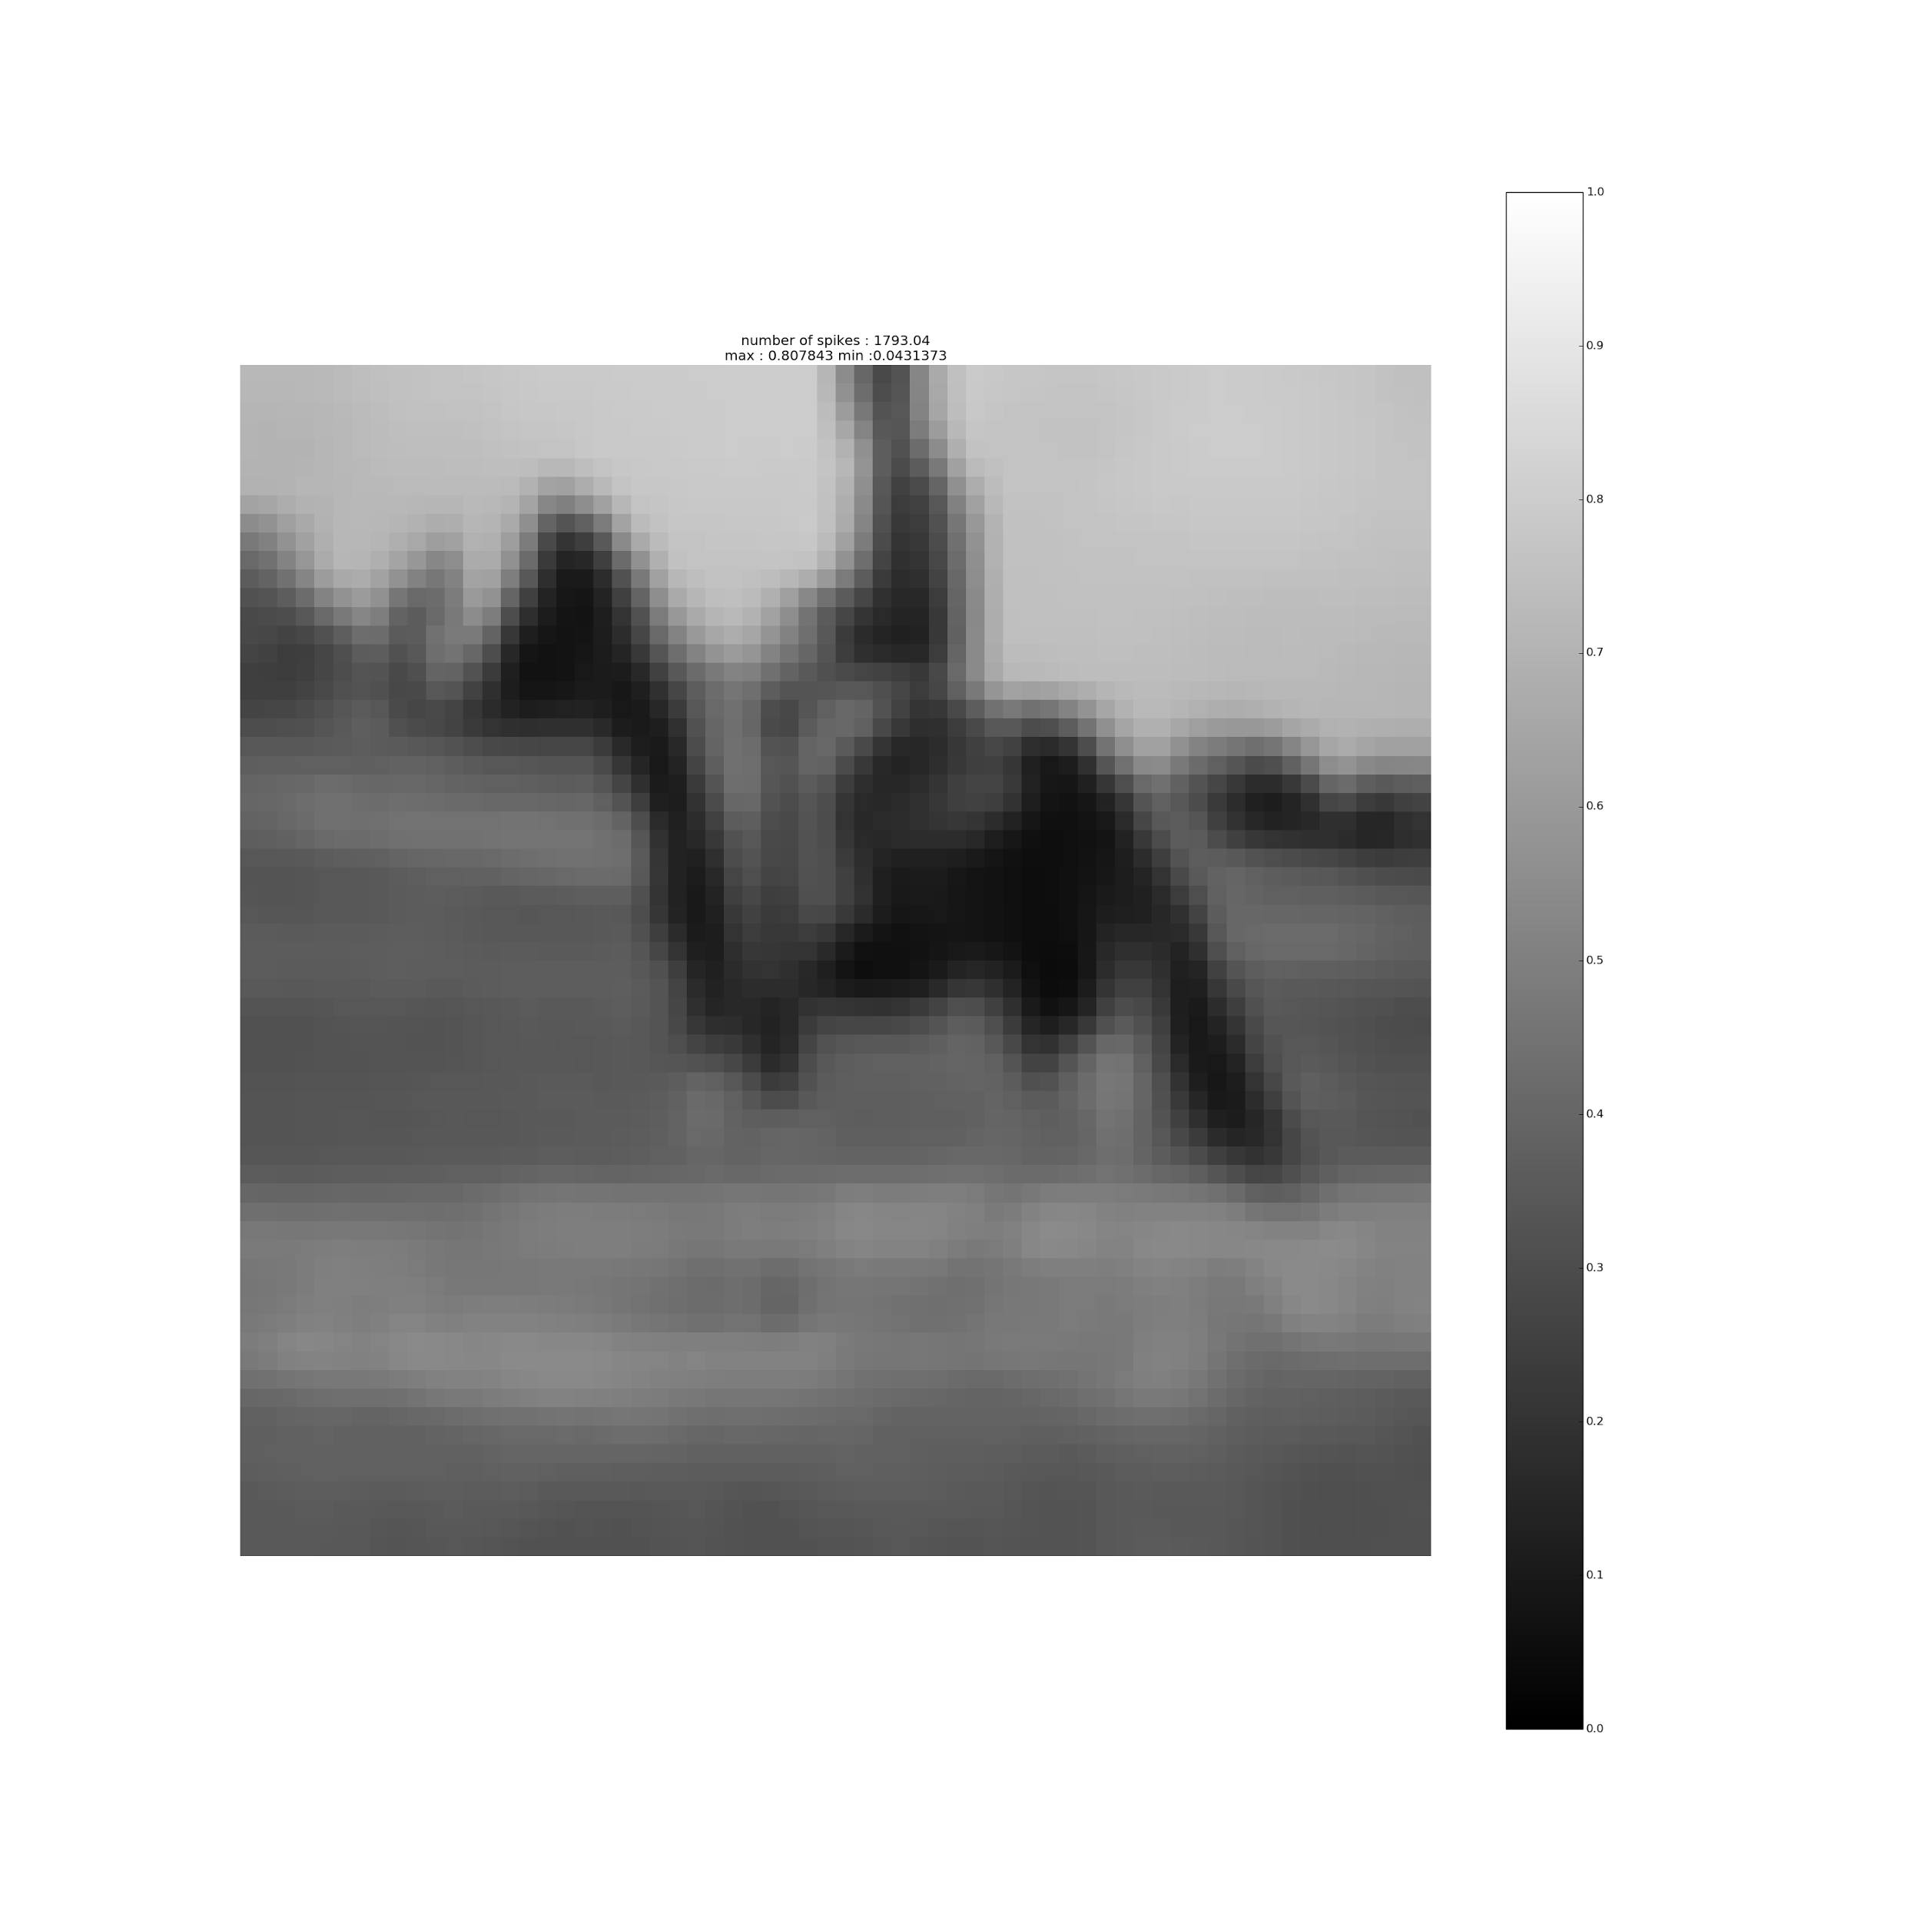
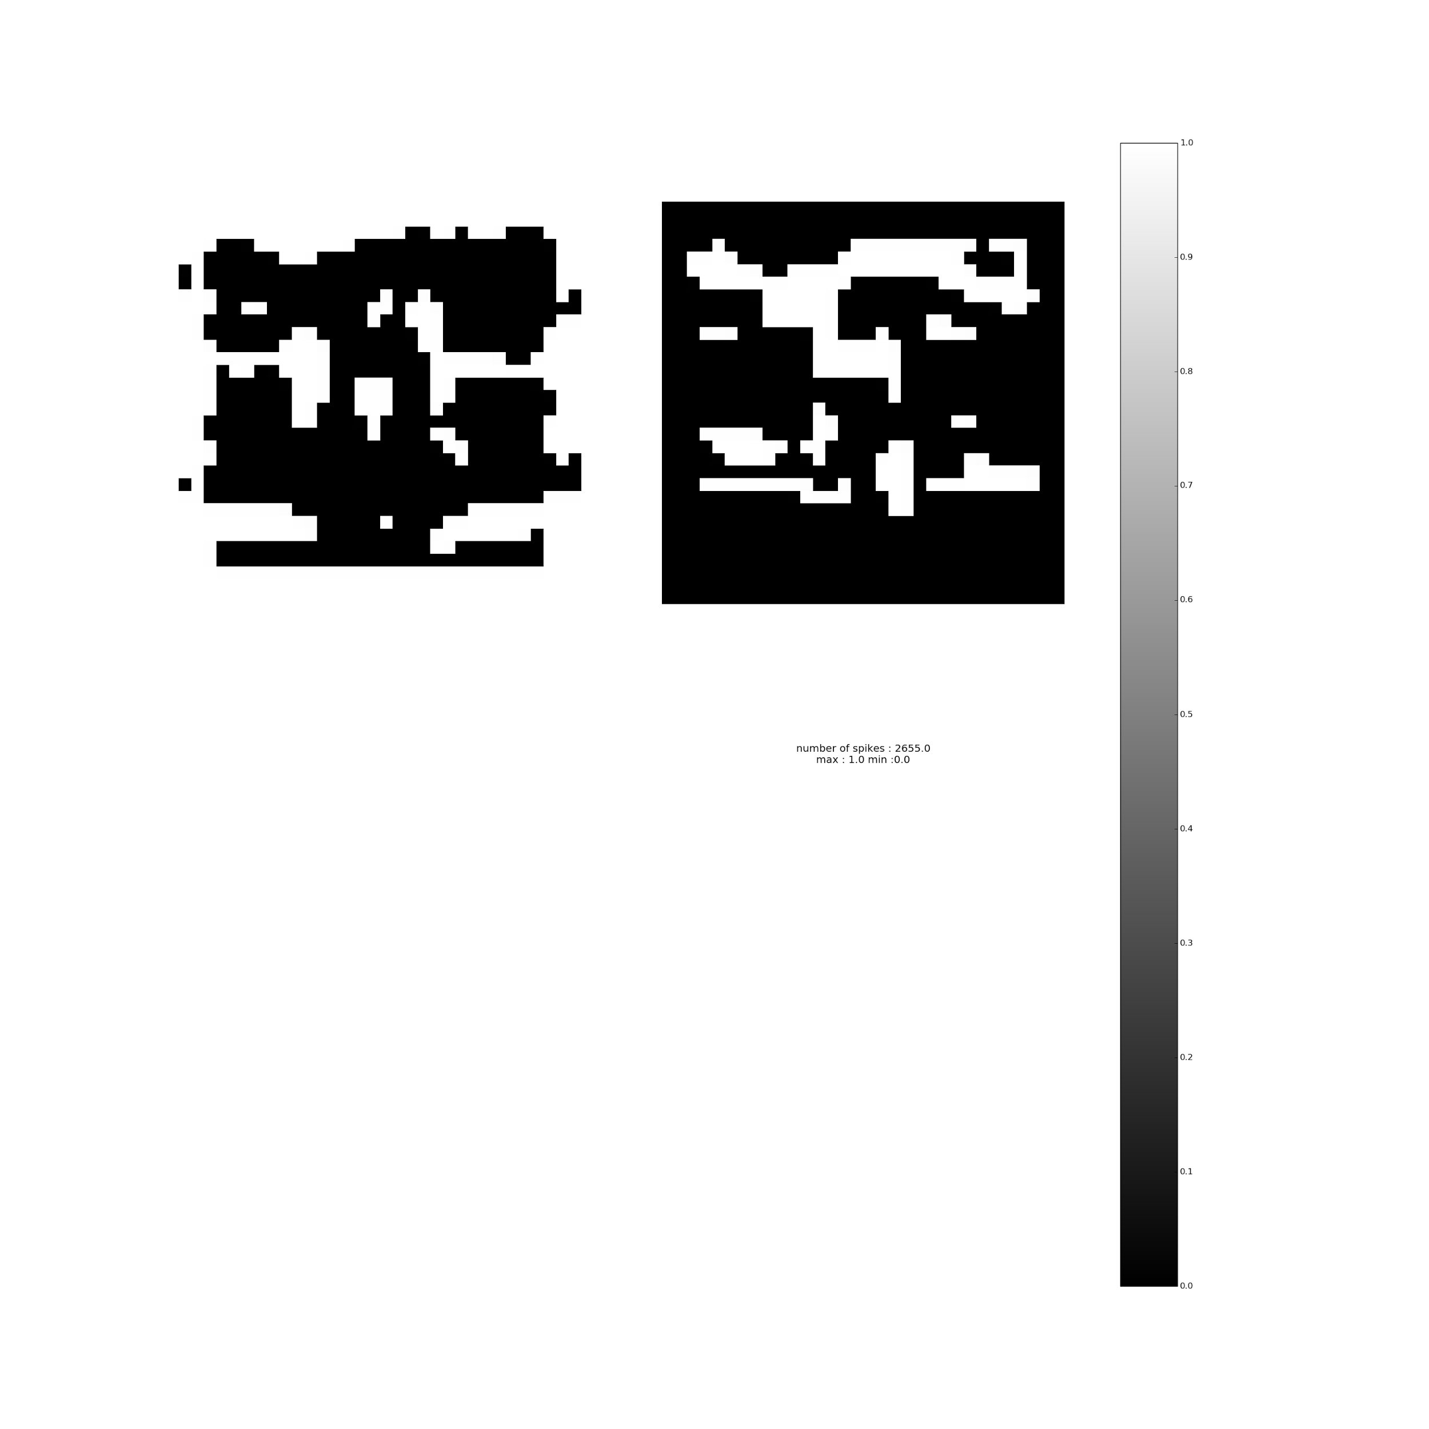
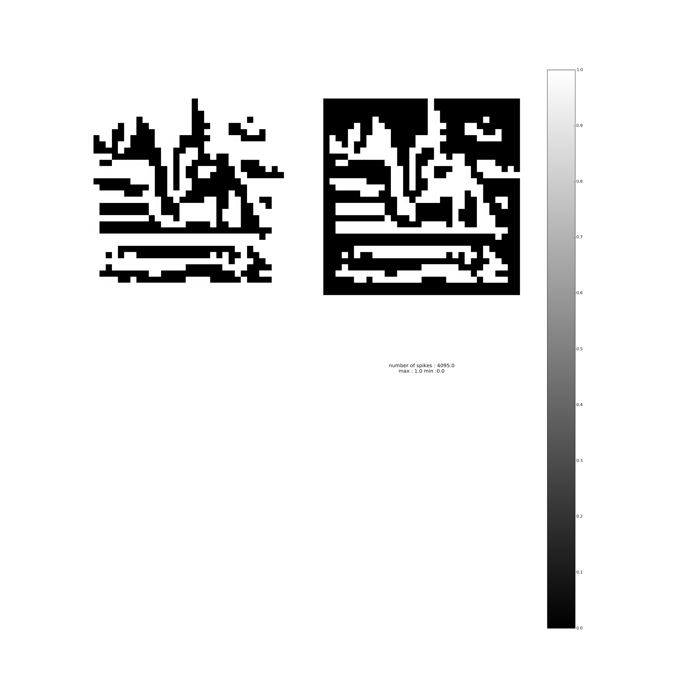


CIFAR - 10
In progress
Major challenges :
Getting a suitable DoG -
Sigma : 1,2
Sigma : 0.3,0.5
Sigma : 0.3,0.5
Resized
Sigma : 0.3,0.5
Resized + Threshold

Slide 37
CIFAR - ARCHITECTURE
S
O
F
T
M
A
X
CONV1
MAX POOL
Global
Max
Pooling
On
Potentials
CONV2
8 filters
64 filters
Thresh : 10
Thresh : 15
Accuracy : 29.42%

Slide 38



DoG
Deconv
Conv1 activation
Conv2 activation

Slide 39
CIFAR - 10
An extra hyperparameter to set - threshold.
Threshold of a layer is to be decided after seeing the activations of the previous layer.
Further investigation required.

Slide 40
ADVERSARIAL IMAGES
No adversarial technique available for SNN.
Trained a standard network with a similar architecture as the SNN and generated adversarial images using FGSM.
SNN is tested on these adversarial images.

Slide 41




ADVERSARIAL IMAGES - MNIST
DoG
Deconv
e = 0.25
 | Standard Network - accuracy % | SNN - accuracy %
Initial - without perturbation | 98.57 | 97.26
e = 0.1 | 64.95 | 82.52
e = 0.2 | 8.34 | 60.34
e = 0.25 | 3.12 | 29.86

Slide 42


ADVERSARIAL IMAGES - CALTECH - Face,Bike
e = 32

Slide 43



Slide 44

Deconv

Slide 45


Deconv

Slide 46
ADVERSARIAL IMAGES - CALTECH - Face,Bike
RESULT
 | Standard Network - accuracy % | SNN - accuracy %
Initial - without perturbation | 98.95 | 96.40
e = 8 | 85.06 | 95.91
e = 20 | 51.45 | 94.46
e = 32 | 29.87 | 89.77

Slide 47
Conclusion and Future Works
Discrete neural networks perform comparable to state of the art but with higher memory and computational efficiency.
Implemented spiking neural network and recreated the results mentioned in the paper.
Tried various combinations on cifar - further investigation required to devise a method to set the threshold in a principled manner.
Promising results on adversarial images generated using FGSM.

